Slide 1
Provider Data Summary
November 2018
Provider Development
Division of Developmental Services

Slide 2
What we will cover
Business Acumen
  Project Update
Baseline Measurement Tool Update
  Enhanced tool demo
  Opportunities
Provider Database
Jump-Start status update
Provider Innovation Collaborative

Slide 3

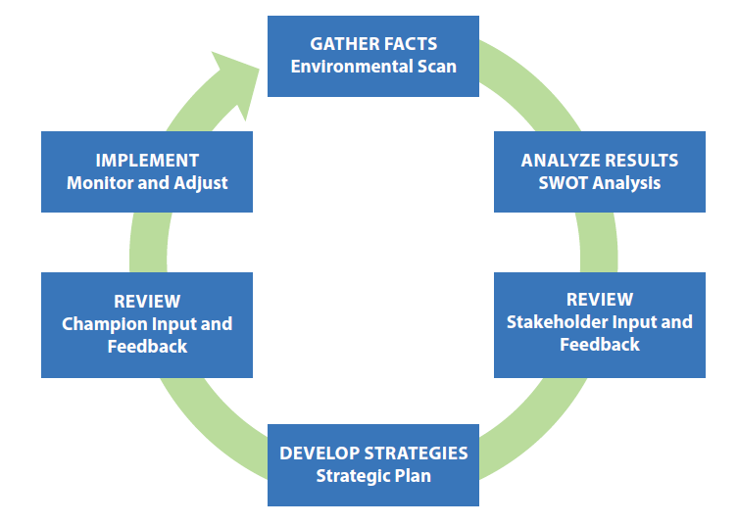
Business Acumen
Step 1 Toolkit available
http://www.hcbsbusinessacumen.org/toolkit.html

Slide 4
Business Acumen
Step 1 Toolkit available
Developing vision and mission
Completing an environmental scan
Completing a SWOT analysis
Identifying stakeholders and champions

Slide 5

Business Acumen
Joint effort
DBHDS, Partnership for People with Disabilities, VBPD, DMAS, Community Providers
Phase one completed
Environmental scan
Participating providers currently completing a SWOT analysis and assisting
with the development of training and resources to improve viability and sustainability
Links to materials can be found here:
http://www.nasuad.org/initiatives/hcbs-business-acumen-center
http://www.hcbsbusinessacumen.org/
Notes:
DBHDS, Partnership for People with Disabilities, VBPD, DMAS and our provider community are committed to a viable and sustainable provider network, we completed the first phase of work which included the completion of an environmental scan- the providers involved with the grant are working on a SWOT analysis. Links to materials can be found here: http://www.nasuad.org/initiatives/hcbs-business-acumen-center
DBHDS and our partners are committed to developing training and resources that will help providers identify system changes, advocate, and to also look inwards to ensure viability and sustainability.

Slide 6
Business Acumen
If you are interested in more information about the Business Acumen Learning Collaborative contact:
Heather Norton
Acting Deputy Commissioner, Developmental Services
Director, Community Support Services
Department of Behavioral Health and Developmental Services
Office: 804-786-5850
Cell: 804-239-5155

Slide 7

Initial Provider Data Report
Drafting Report
Summarizing changes in data from April to November 2018
Communicating
challenges and opportunities

Slide 8
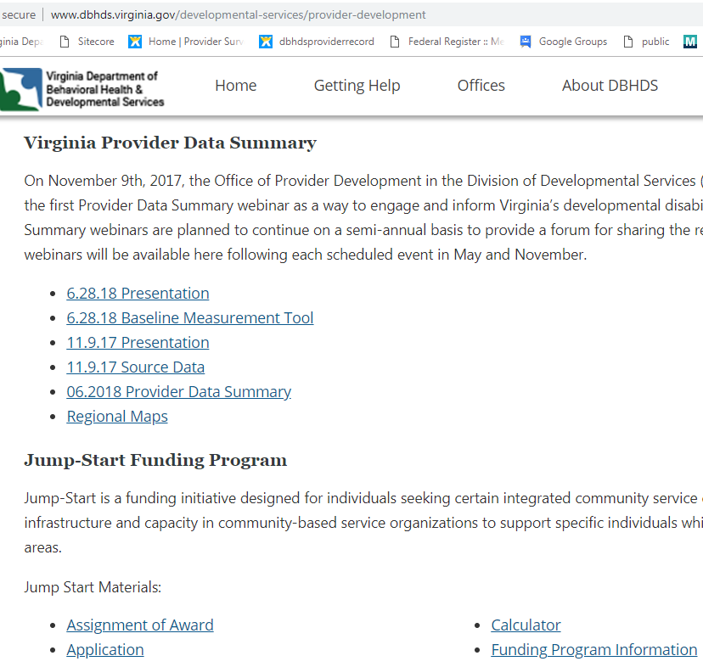
Initial Provider Data Report
Updated
Provider Development webpage:
http://www.dbhds.virginia.gov/developmental-services/provider-development

Slide 9
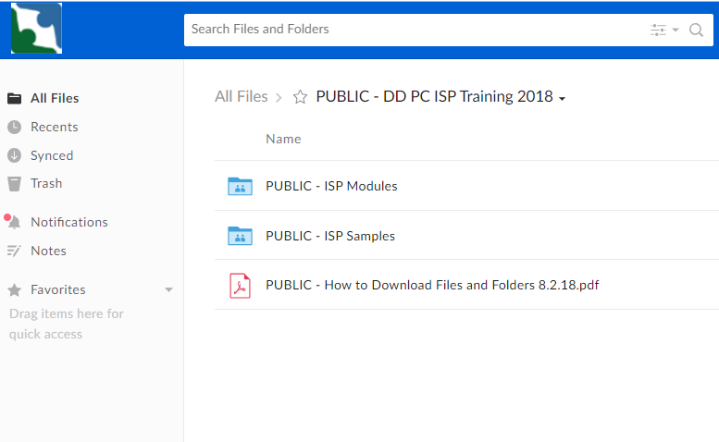
Initial Provider Data Report
Resolving access to Box.com files

Slide 10
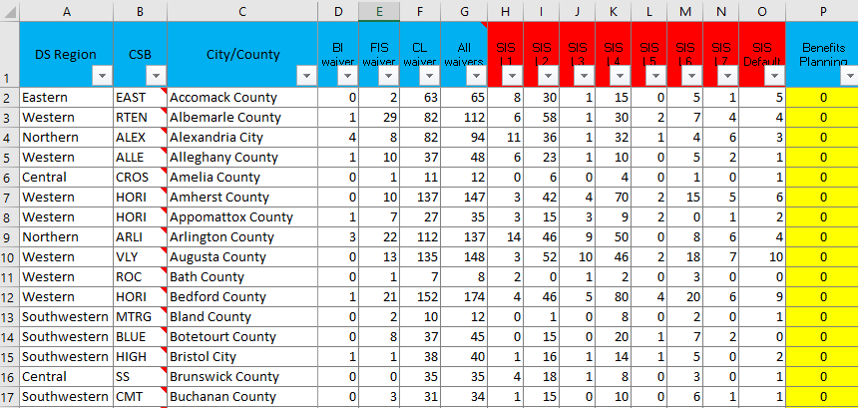
Enhanced Baseline Measurement Tool

Slide 11
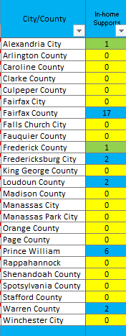
Understanding Provider Data
Numbers represent service availability by providing unique provider counts per locality
Providers may be counted in more than one locality, but only once in any single locality

Slide 12
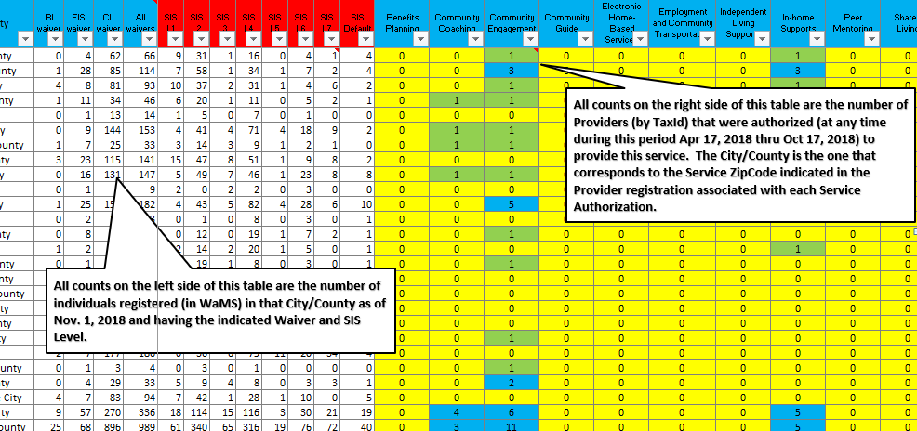
Understanding Provider Data
Individual data is not directly correlated with provider data. This means that the tool conveys how many people live in a given locality, and then the number of providers authorized there.

Slide 13
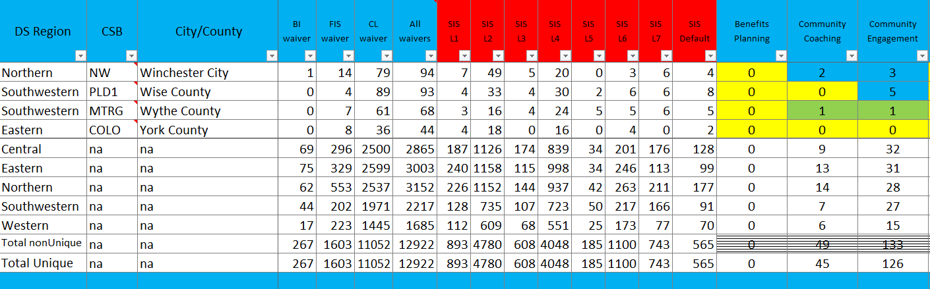
Understanding Provider Data
Total, actual provider counts are located at the bottom of each tab

Slide 14
Enhanced Baseline Measurement Tool
Demo

Slide 15
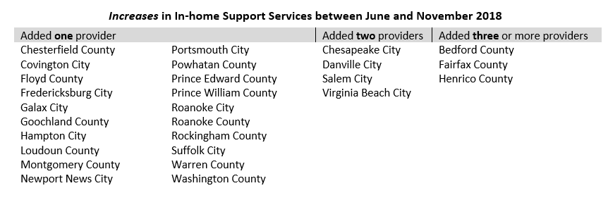
Using the Baseline Measurement Tool
Has there been any movement in the availability of In-home services?

Slide 16
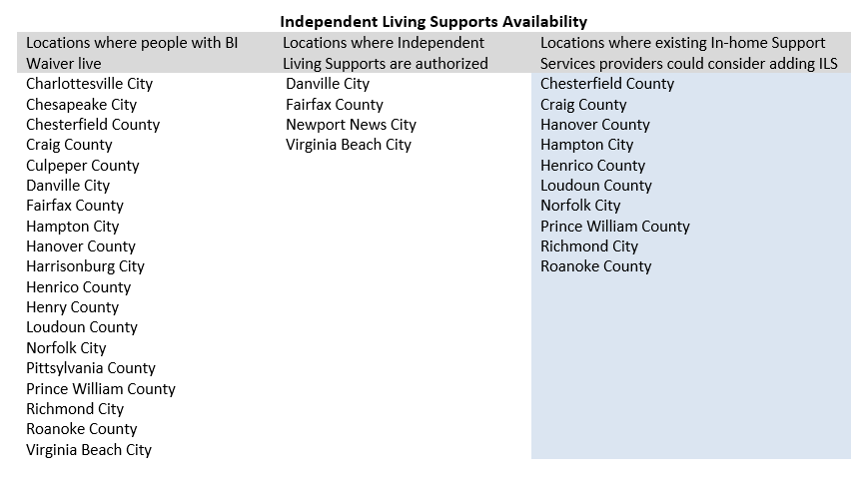
Using the Baseline Measurement Tool
Where might In-home Providers offer Independent Living Services?

Slide 17
Using the Baseline Measurement Tool
Which communities might need nursing services the most?

Slide 18
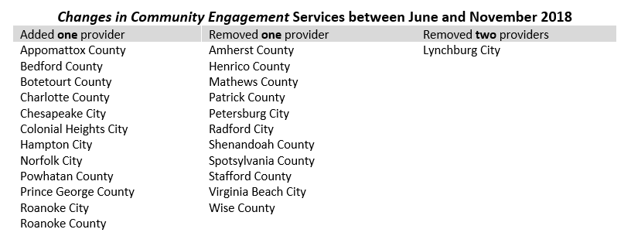
Using the Baseline Measurement Tool
Are there any new opportunities to start Community Engagement?

Slide 19
Examples
Scenario 1
ABC, Inc. is seeking to diversify by offering Community Engagement in the Central region.
They are looking for a community where their services are needed and there are a sufficient number of people who would access their services.
Location = Central Region
People = at least 30 people with DD waiver
Services = less than 2 providers of CE

Slide 20
Examples
Scenario 2
XYZ, Inc. is an established group home provider and is seeking to offer more integrated models of service to the people in their homes.
They are looking to remain in Chesterfield County, but want to diversify their business model.
Location = Chesterfield
Services = which integrated services are needed

Slide 21
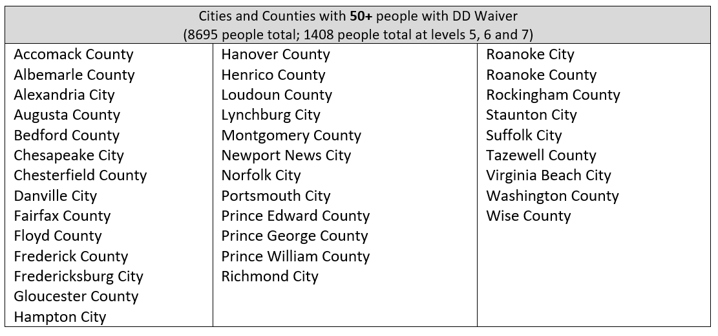
Opportunities across Regions
Which areas have 50 or more people with DD Waiver?

Slide 22
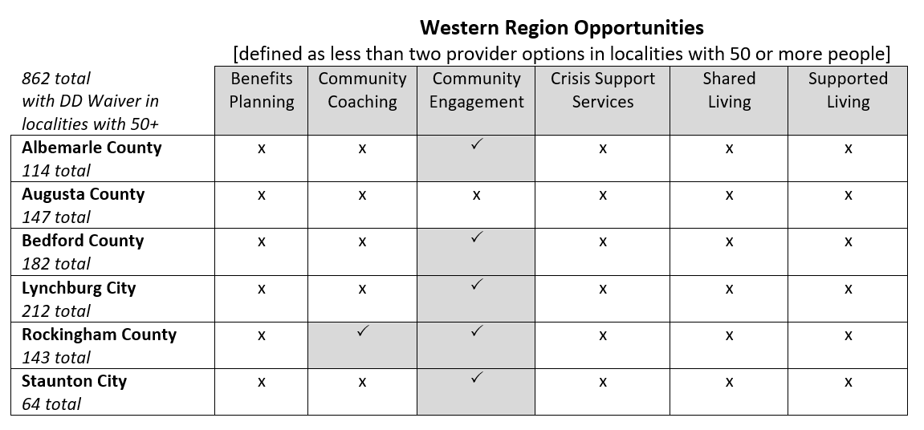
Opportunities across Regions
“x” equals a possible opportunity for development
Notes:
In slides 22-26, the check mark indicates two or more providers of the service are operating in the identified locality. The “x” indicates 1 or zero providers are authorized in the area.

Slide 23
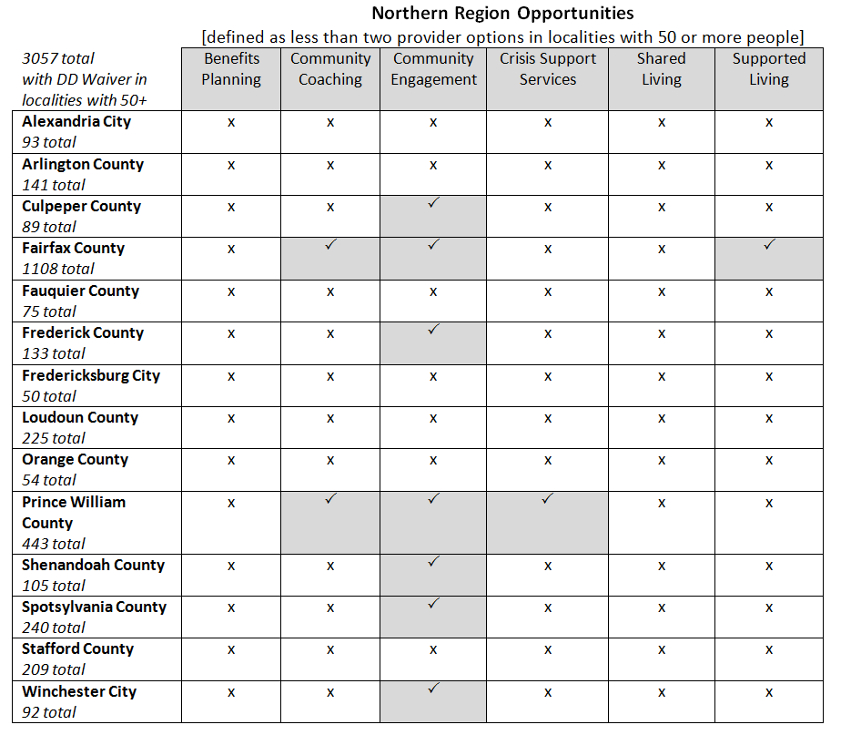
Opportunities across Regions

Slide 24
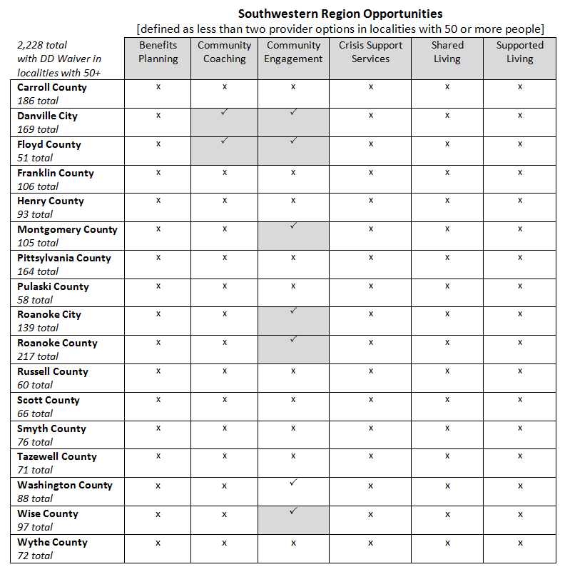
Opportunities across Regions

Slide 25
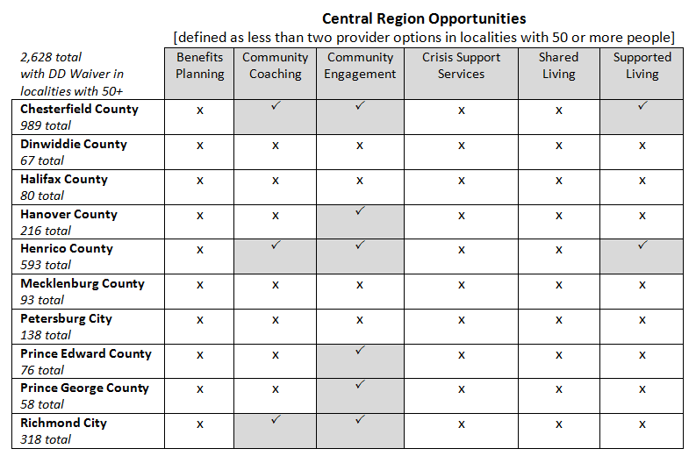
Opportunities across Regions

Slide 26
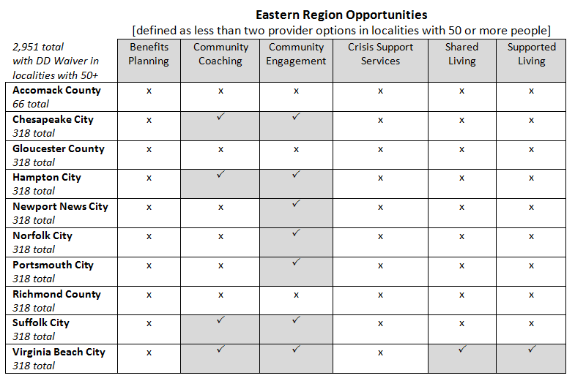
Opportunities across Regions

Slide 27
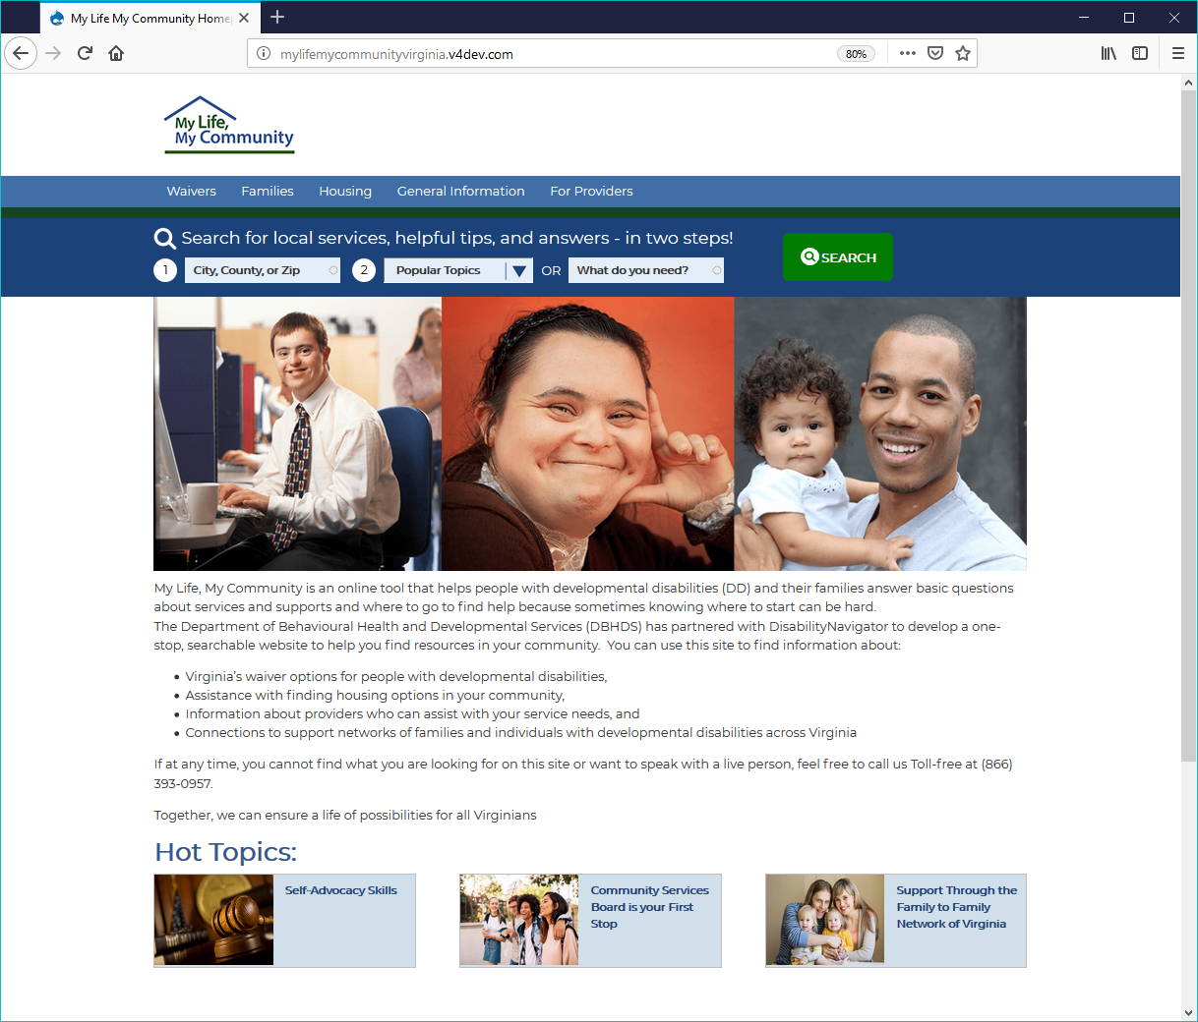
Provider Database
In development

Slide 28
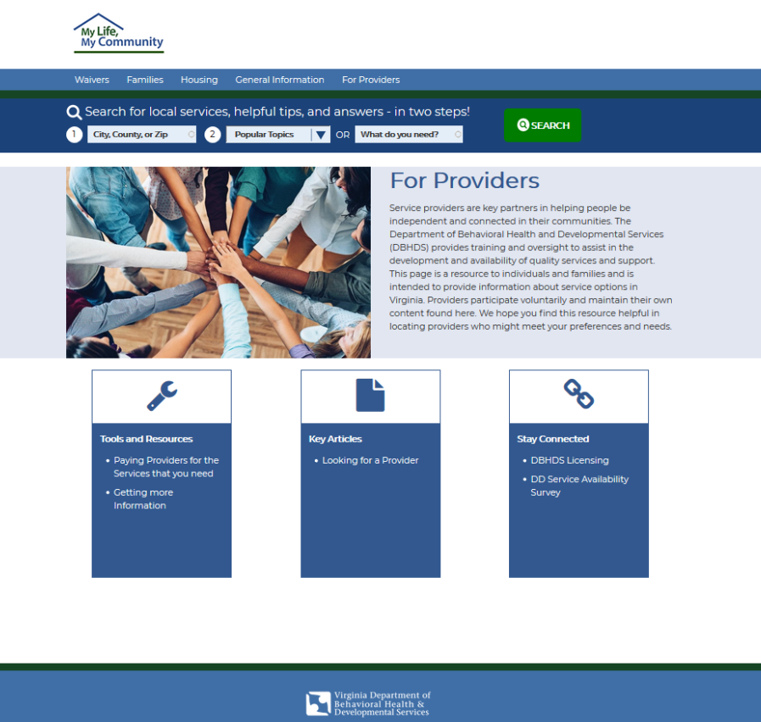
Provider Database
Includes searchable provider database

Slide 29

Jump-Start Status
Three applications received to date
One approval creating six Supported Living apartments and five ILS program options

Slide 30

Provider Innovation Collaborative
March 27-29 in Richmond
Agencies and speakers from Virginia, North Carolina, Minnesota and Philadelphia
Four tracks:
Business Acumen
Best Practices
Quality Improvement
Supporting Crisis

Slide 31
Next Steps
Finalize Provider Data Summary Report
Post report and enhanced baseline tool online and announce
Distribute Jump-Start Flyer and discuss at Roundtables
Distribute registration for the Provider Innovation Collaborative
Bring Provider Database online

Slide 32

Questions?

