Slide 1
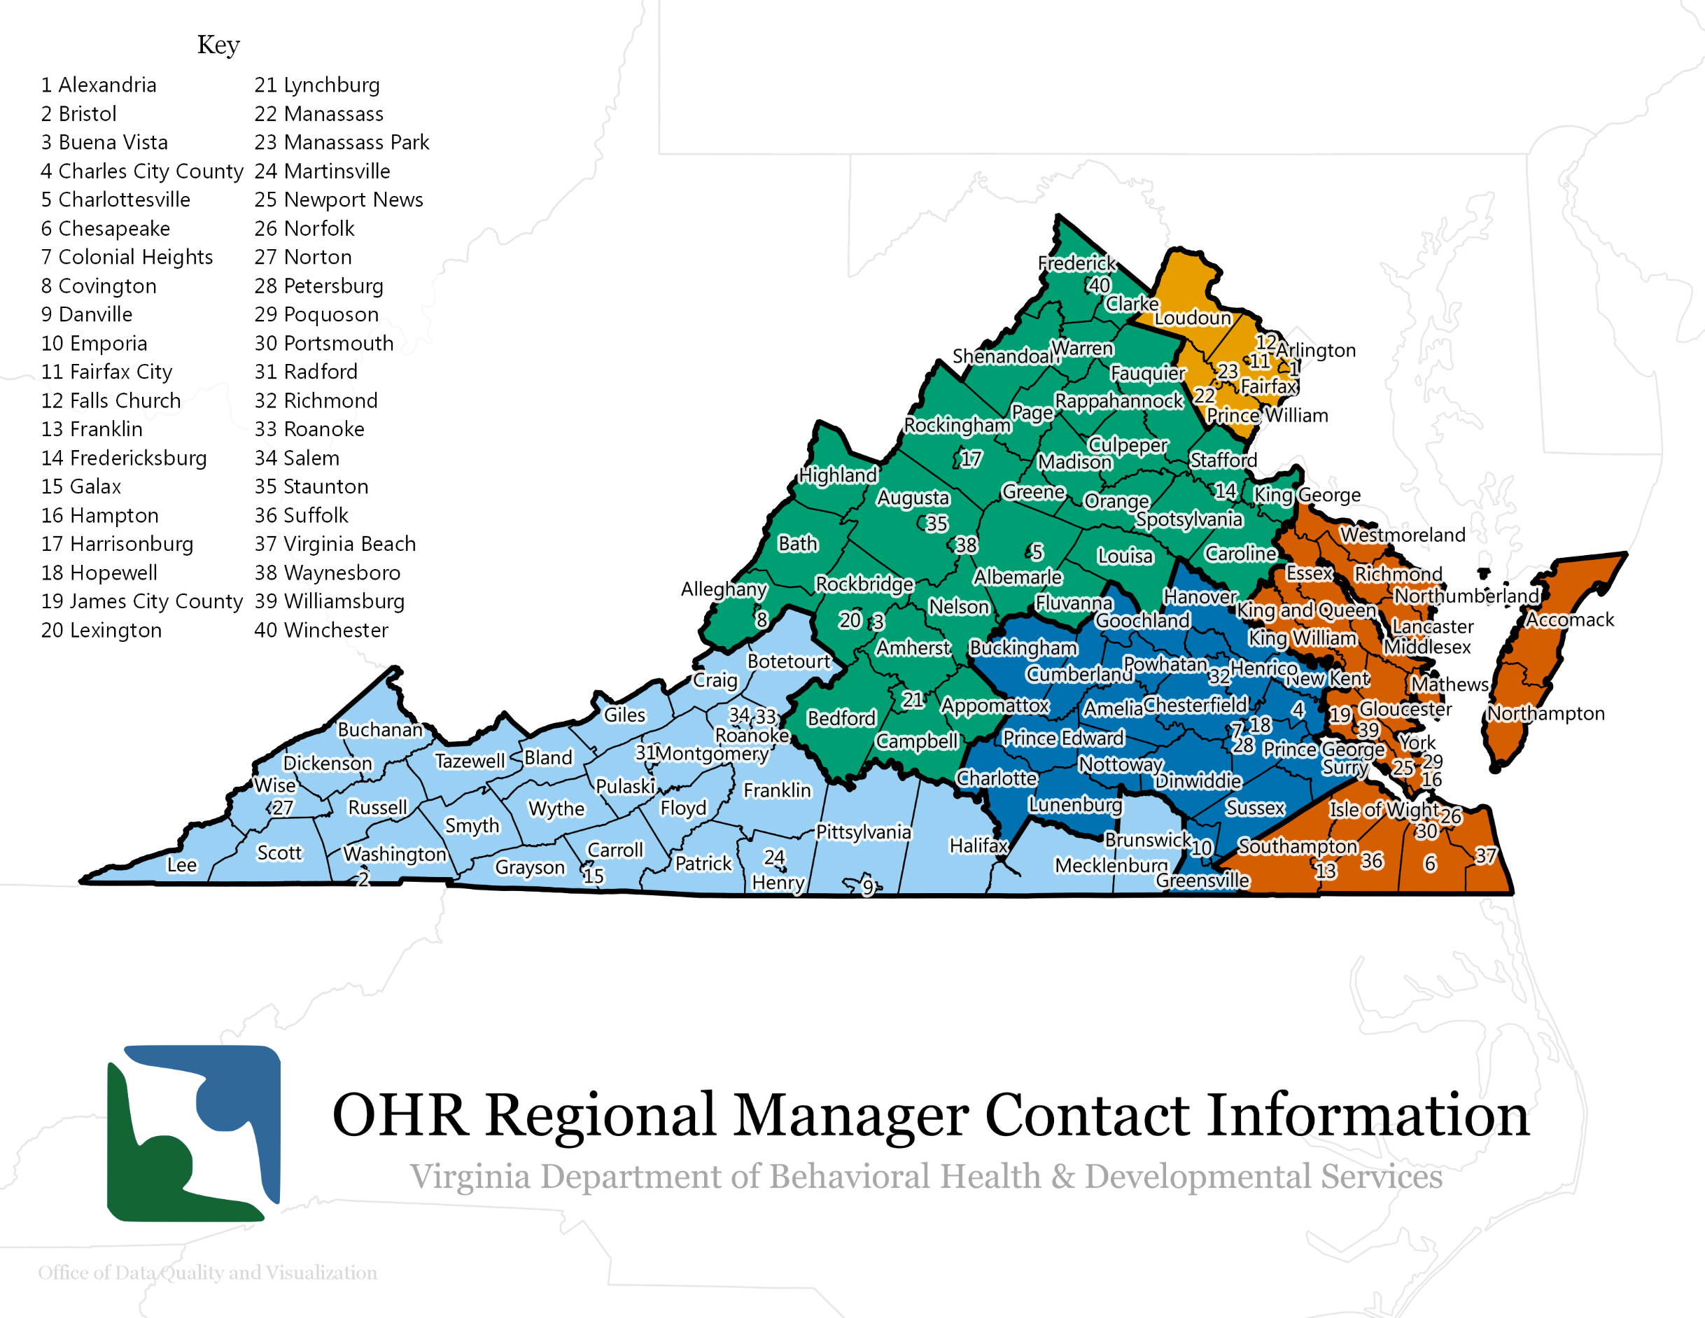
2
Ann Pascoe | 804.297.1503
ann.Pascoe@dbhds.virginia.gov
Cassie Purtlebaugh | 804.382.3889
cassie.purtlebaugh@dbhds.virginia.gov
1
Jennifer Kovack | 804.248.8043
jennifer.kovack@dbhds.virginia.gov
3
4
5
Sharae Henderson | 804.524.7479
sharae.henderson@dbhds.virginia.gov
Reginald Daye
804.253.7061
reginald.daye@dbhds.virginia.gov

