Slide 1
Adapting to Change: Defining Change Management

Slide 2
Agenda
Introductions
Defining change management
Individual and organizational change management
Who is involved in managing change
Change management and project management
Notes:
G

Slide 3
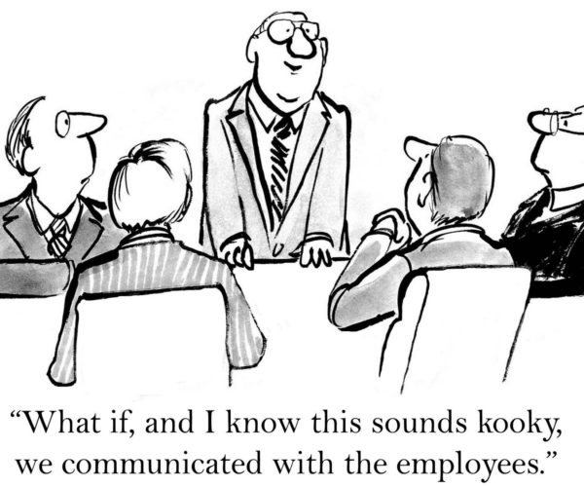
Change management is:
The process, tools and techniques to manage the people side of change to achieve the required business results.

Slide 4
Change management is like project management
Both aim to deliver value to the business by supporting initiatives and projects
However, it is the ‘people side’ of change

Slide 5
Prosci® PCTTM Model
Leadership / Sponsorship provides guidance and governance
Project Management gives structure to the technical side of the change
Change Management supports the people side of the change
All three elements must be present for project success

Slide 6
Organizational change can be represented as three states of change
Current
State
Transition
State
Future
State
Organization
How I will do my job after the change is implemented
How I do my job today
Making the needed changes
Current
State
Transition
State
Future
State
Individual

Slide 7
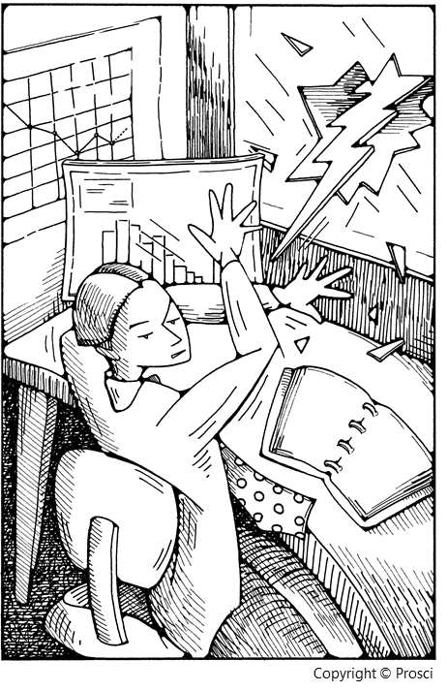
There are consequences of not managing the people side of change
Passive resistance
Ignoring
Non-participation
Procrastination
Mishandling
Active resistance
Arguing
Ridiculing
Distorting
Blocking

Slide 8
Primary Reasons for Applying Change Management
Increase probability of project success
Manage employee resistance to change
Capture people- dependent ROI
Build change competency into the organization

Slide 9
The Five Building Blocks for Successful Change

Slide 10
ADKAR® forms the foundation of successful organizational change
Ultimately, for a project or initiative to be successful, individuals in the organization have to do their jobs differently
ADKAR provides a framework for understanding how individuals change
Managers and project teams can use ADKAR to:
Guide organizational change management plans
Diagnose gaps and root causes of resistance
Develop corrective actions

Slide 11
Prosci ADKAR Model
ADKAR element: | Definition: | What you hear: | Without:
Awareness | Of the need for change | “I understand why…” | Employees ask the same question over and over Hoarding of information and resources
Desire | To participate and support the change | “I have decided to…” | Lower productivity Increased turnover Delays in implementation
Knowledge | On how to change | “I know how to…” | Lower utilization or incorrect usage of new systems Sustained reduction in productivity
Ability | To implement required skills and behaviors | “I am able to…” | Employees worry whether they can be successful in the future Greater impact on customers and partners
Reinforcement | To sustain the change | “I will continue to…” | Employees revert back to old ways of doing work Ultimate utilization is less than anticipated The organization creates a history of poorly managed change

Slide 12
Managing individual change with ADKAR®
ADKAR® describes the key building blocks for successful change
Personal or professional
Success with change requires all elements of the ADKAR® Model to be present
Prosci® ADKAR® Model

Slide 13
Who is involved in managing change?
Senior Leaders
Managers and Supervisors
Change Management
Project
Team
Employees

Slide 14
Change Management Resource
The change management resource on a project plays the following enabler roles:
The conductor of the orchestra
The director of the play
Effective change management requires involvement and action by many in the organization
Change Management

Slide 15
Senior Leaders
Why is this group important?
Active and visible sponsorship is identified as the top contributor to overall project success in Prosci’s five benchmarking studies
Senior leaders are one of two preferred senders of messages about change
What is this group’s role?
Participate actively and visibly throughout the project
Build the needed coalition of sponsorship with peers and other managers
Communicate the business messages about the change effectively with employees
Senior Leaders
Change Management

Slide 16
Managers and Supervisors
Why is this group important?
Managers and supervisors are the other preferred sender of messages about change
This group has a unique and well-developed relationship with the employees being impacted by the change
What is this group’s role?
Communicate the personal messages about the change with their direct reports
Conduct group and individual coaching sessions
Identify, analyze and manage resistance
Provide feedback to the rest of the change management ‘gears’
Managers and Supervisors
Change Management

Slide 17
Project Team
Why is this group important?
The project team designs and develops the ‘change’ – they are the ones who introduce new processes, systems, tools, job roles and responsibilities
This group provides much of the specific information about the change to the other ‘gears’
What is this group’s role?
Provide timely, accurate and succinct information about the change (or project)
Integrate change management activities into project management plans and activities
Change Management
Project
Team

Slide 18
Employees
Why is this group important?
Employees will ultimately make changes to how they do their day-to-day work
Their acceptance and use of the solution determines the success of the project and the ongoing benefit derived from the change
What is this group’s role?
Seek out information related to the business reasons for change and the personal impact of the change
Provide feedback and reaction to the change and the change management efforts
Take control of the personal transition (using an individual change management model like ADKAR)
Change management
Employees

Slide 19
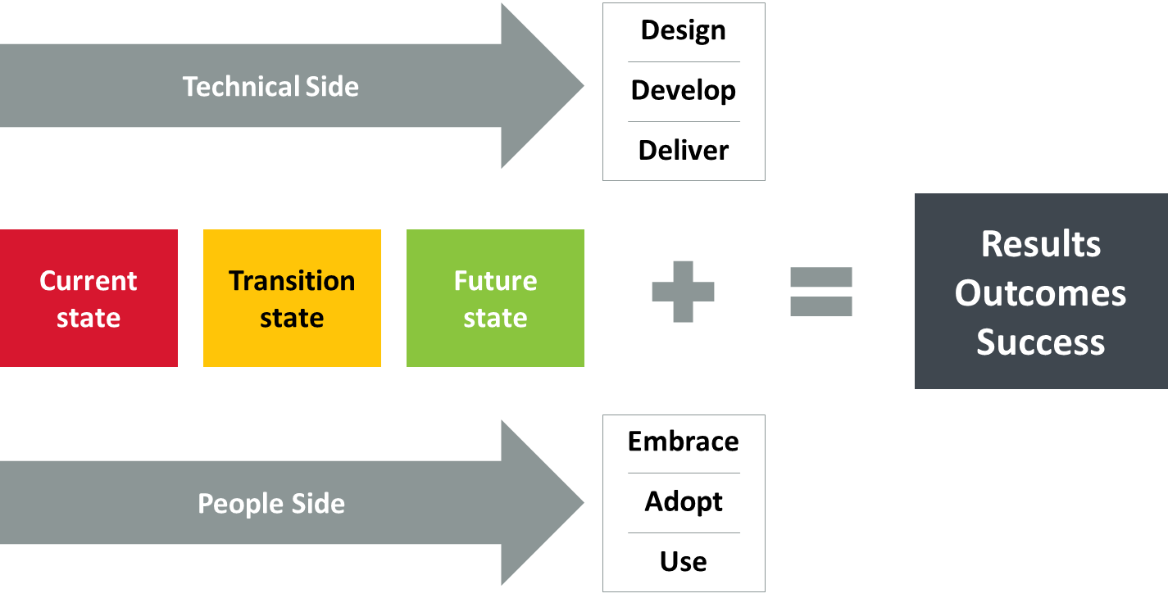
Change management is:

Slide 20
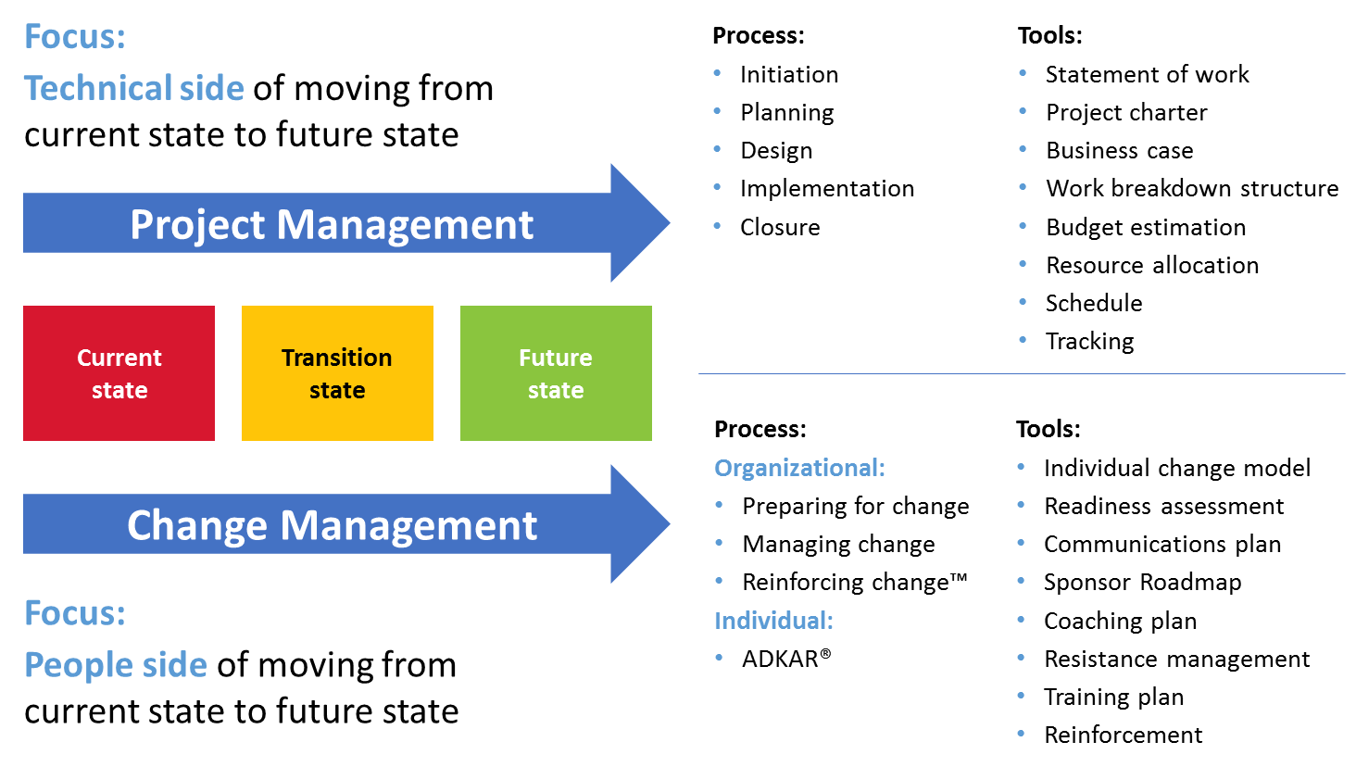
Change management is:

Slide 21
The right amount…
How much project management is needed?
Depends on the complexity and degree of change to processes, systems, organization structure and job roles
How much change management is needed?
Depends on the amount of disruption created in individual employees’ day-to-day work and the organization attributes like culture, value system and history with past changes

Slide 22
When do you start change management?

Slide 23
Conclusion
Change management focuses on the ‘people side’ of organizational change
Change management involves both an individual and an organizational perspective
Change management requires action and involvement by leaders and managers throughout the organization
Change management and project management are both tools that support project benefit realization – project management is the ‘technical’ side and change management is the ‘people’ side
Change management is most effective when it is launched at the beginning of a project and integrated into the project activities

Slide 24
Thank You
Office of Management Services
omspmteam@dbhds.Virginia.gov

