Slide 1

Promoting Skin Integrity and Preventing Pressure Sores
……Is Everyone’s Responsibility

Slide 2
WELCOME
Place personal information of presenters here.
House Keeping
Expectation
Pre-test completed

Slide 3
Our Goals…
Zero pressure sores or areas of skin breakdown on any individual.
Quick recognition and interventions when breakdown occurs, leading to early closure of decubitus ulcers.
Staff will have the knowledge, skills and ability to provide for the needs of even the most vulnerable individuals using a interdisciplinary team approach.
That this curriculum is spread via “train the trainer” (We train you so you will go out and train your staff)
Nursing will provide the leadership to assure that all staff receives the training needed to provide high quality care using best practices for individuals who are at risk or who have chronic health conditions.

Slide 4
Objectives: Learners will:
State the importance of good skin integrity on the overall health of individuals with IDD.
Recognize the need to report any change in the skin to the right health team member immediately.
List at least two factors that can cause skin breakdown.
Name two ways that skin breakdown (decubitus ulcers) can be prevented.
Understand the process of providing good skin care while bathing, positioning and changing individuals with high personal care needs.
Understand their role in preventing skin breakdown and in the treatment process when breakdown occurs.
Recognize the professionals involved in the treatment of decubitus ulcers.
Understand how to properly document on the health issues of individuals at risk or with skin breakdown (decubitus ulcers).

Slide 5

Healthy Skin Is Very Important
Skin is the largest organ in the body
Skin prevents infection from outside sources entering in to the body.
The skin protects us from heat, cold and the elements.
The skin helps regulate body temperature
The skin permits the sensations of touch, heat, and cold.
The skin stores fat and water to help with shock absorption and to prevent dehydration.

Slide 6
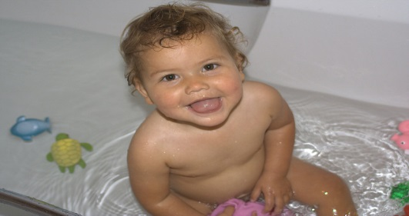
Keeping Skin Healthy
It is important to have clean, well lubricated skin to prevent skin from breaking down and becoming torn and/or infected.
Bathing often and cleaning all parts of the skin with mild soap and water is essential.
Applying a lubricant cream or lotion per a health care providers prescription is important.
Inspecting the skin and seeking treatment from a medical professional for changes in the skin can reduce long term complications including decubitus Ulcers.

Slide 7

Why do skin infections happen?
Poor skin hygiene
Poor housekeeping practices
Long term use of antibiotics
Germs transmitted from person to person by direct or indirect contact
Build up of bacteria and other germs on or within the skin
Germs get into cracks or breaks in the skin causing infection that can effect the whole body.

Slide 8

Activity #1
Sit quietly in an uncomfortable position without moving for 5 minutes.

Slide 9
What is a Pressure Sore?
Also known as “pressure ulcers” , “decubitus ulcers” and “bed sores”.
It is an injury to the skin and underlying tissue resulting from prolonged pressure and/or friction on the skin.
Pressure against the skin reduces the blood flow to the skin and nearby tissue , stopping the flow of oxygen.
This reduced blood flow causes the skin to redden then open causing a wound which can be very deep and difficult to heal.

Slide 10
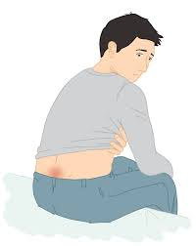
What Causes Pressure Sores?
Prolonged Pressure:
An individual is lying or sitting in a position for a prolonged period of time. The flow of blood is decreased and/ or stops flowing to the area. The skin and tissue becomes damaged and reddens then opens.

Slide 11
Be aware that there are areas on the body that are at higher risk of breaking down due to pressure and friction.
Name some of these areas.

Slide 12
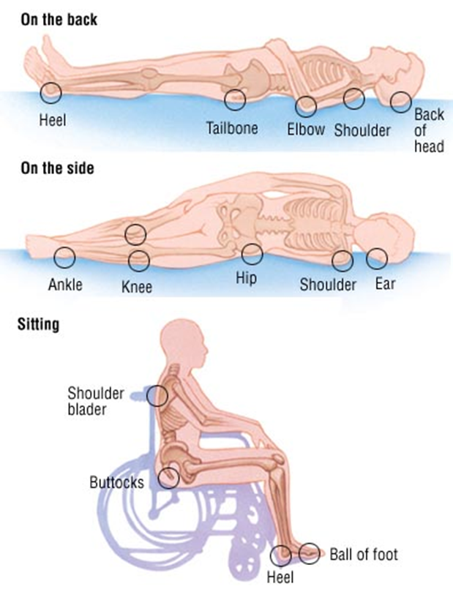
Common Pressure Points

Slide 13
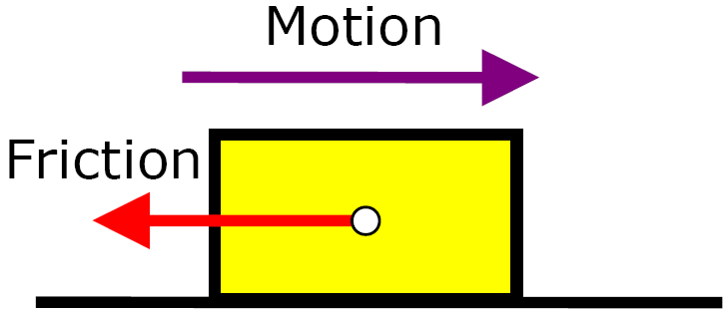
What are Other Causes of Pressure Sores?
Friction: This is the resistance to motion. This may occur when the skin is dragged across a surface, such as when you change position or you are moved or repositioned by a care giver. If the skin is moist, (wet brief) the friction is worse and can cause significant skin and tissue damage.
How can you stop friction from happening?

Slide 14
Causes continued….
What other devices and objects that a person may use can cause pressure and friction?
Answers: Splints, rolls, abdominal binders, medical-tubing, oxygen tubing, CPAP, G-tubes, catheters, socks, clothing, sheets, towels, draw sheets when wrinkled or bunched, hand held toys or manipulatives.

Slide 15
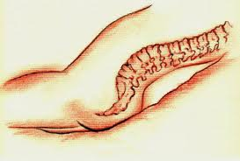
More Causes of Pressure Sores?
Shear: This occurs when two surfaces move in opposite directions. For example, when an individual slides down in their bed. As the tailbone moves down, the skin over the bone may stay in place, pulling the skin in the opposite directions.
The person is usually at an angle when this occurs.
When is a person at an angle?

Slide 16
Activity #1 Follow Up
How do you feel now after sitting for 5 minutes in an uncomfortable position?
Imagine sitting like that for over an hour or more?
What can you do to prevent a person you care about from feeling this way?

Slide 17
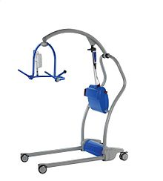
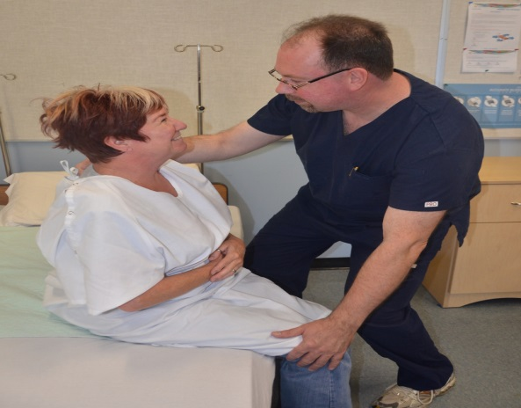
Activity #2
Demonstrate proper and improper body movement in bed.
Demonstrate improper and proper wheelchair positioning and repositioning.
Or show a video

Slide 18
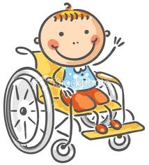
Who is at Risk for Pressure Sores?
Individuals with:
Poor health including those with chronic health conditions.
Individuals who take 8 or more medications.
Paralysis, heavy sedation or who are in a coma.
Individuals who are post surgery/or have recently had a medical procedure where they are now less mobile and aware.

Slide 19
More Risk Factors?
People with fragile skin, skin tears and chronic skin problems such as rashes.
Older adults – the skin of older adults is generally more fragile.
Lack of sensory perception - spinal cord injuries, neurological disorders that result in loss or decreased sensation.
Weight loss- this is more common during prolonged illness. The loss of fat and muscle result in less cushioning between bones and a hard surface.
Immobility- the individual is not able to move themselves resulting in long periods of time with pressure on one area.

Slide 20
And More Risk Factors? (cont’d)
Poor nutrition and hydration – good nutrition and the right amount of fluids such as water are important to maintain healthy skin and good skin integrity.
Excess moisture and/ or dryness - skin that is overly moist is more likely to be injured and tears easily. Very dry skin increases the risk of friction.
Bowel and urinary incontinence- bacteria from urine and fecal matter (stool) can cause serious local infections and can lead to life threatening infections.
Exposure to Shear and/or friction- using proper lifting and positioning technics can prevent exposure to both friction and shear.
(www.cdc.gov/nchs/products/databriefs/db14.htm)

Slide 21
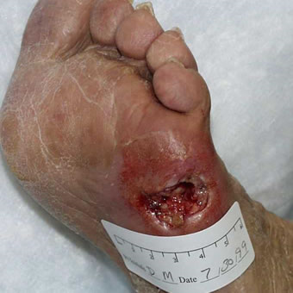
What are Risk Factors? (cont’d)
Diabetic foot ulcer
Medical conditions- ex. Diabetes, vascular diseases.
Smoking- Smoking reduces the amount of blood flow and limits the oxygen in the blood. Smokers wounds tend to heal more slowly.

Slide 22
Activity #3
Checking for Incontinence and Changing a Soiled Brief
Gather supplies
Wash hands
Position properly
Remove soiled brief
Wipe from front to back (avoid vagina)
Pat dry or allow to air dry
Apply barrier cream per prescription
Replace new brief (Do not double brief or pad the brief)
Position with all surfaces flat and dry

Slide 23
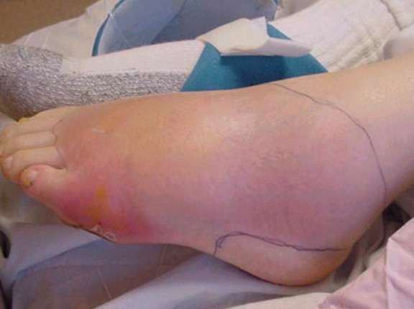
Complications from Pressure Sores (cont’d)
Cellulitis: cellulitis is an infection of the skin and connected tissues. It can cause severe pain, redness, and swelling. People with nerve damage can often not feel this pain. Cellulitis can lead to life threatening complications.
Call a health care provider immediately upon observation

Slide 24
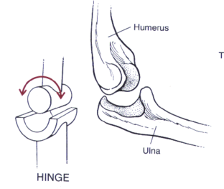
Complications from Pressure Sores (cont’d)
Bone and joint infections: the infection from the pressure sore can travel into the joints and bones. This can damage cartilage and may reduce the function of the joints and limbs.
Cancer: This is possible with chronic non-healing wounds. This can be aggressive and requires surgery.

Slide 25
Sepsis Is A Severe Complications that can lead to death!
Sepsis is a complication caused by the body’s overwhelming and life-threatening response to an infection, which can lead to tissue damage, organ failure, and death.
Sepsis is often associated with infections of the lungs (e.g., pneumonia), urinary tract (e.g., kidney), skin, and gut.
A CDC evaluation found more than 90% of adults and 70% of children who developed sepsis had a health condition that may have put them at risk.
(https://www.cdc.gov/sepsis/basic/qa.html)

Slide 26
Signs of Sepsis
There is no single sign or symptom of sepsis. It is, rather, a combination of symptoms. Since sepsis is the result of an infection, symptoms can include infection signs (diarrhea, vomiting, sore throat, etc.), as well as ANY of the symptoms below:
Shivering, fever, or very cold
Extreme pain or discomfort
Clammy or sweaty skin
Confusion or disorientation
Short of breath
High heart rate
Get Help Immediately!!!
(https://www.cdc.gov/sepsis/basic/qa.html)

Slide 27

Activity #4
Early identification and immediate reporting of any change resulting in appropriate interventions helps prevent death and other injuries.
You Are The Key!!!
Completing a Health Screening and Reporting ALL Changes: a Skit.

Slide 28
Treatment of Decubitus Ulcers by Health Professionals
Pressure ulcer treatment should be evidence-based and include a patient assessment and wound evaluation, including the following elements: history and physical, wound description/staging, etiology of pressure, psychosocial needs, nutritional status, and bacterial colonization/infection.
Document all risk assessments, skin inspection findings, pressure ulcer prevention interventions and treatments. Utilize a consistent documentation format.
(https://www.icsi.org/guidelines)

Slide 29
When Skin Break Down Happens, Medical professionals Talk About It In Categories Called Stages

Slide 30
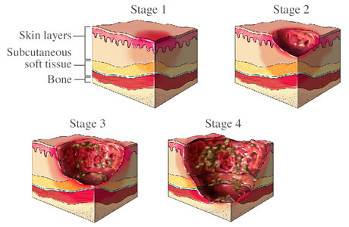
Stages of Pressure Ulcers
There are different stages of pressure ulcers, Stage 1 being the least serious and Stage 4 being the most serious condition.

Slide 31
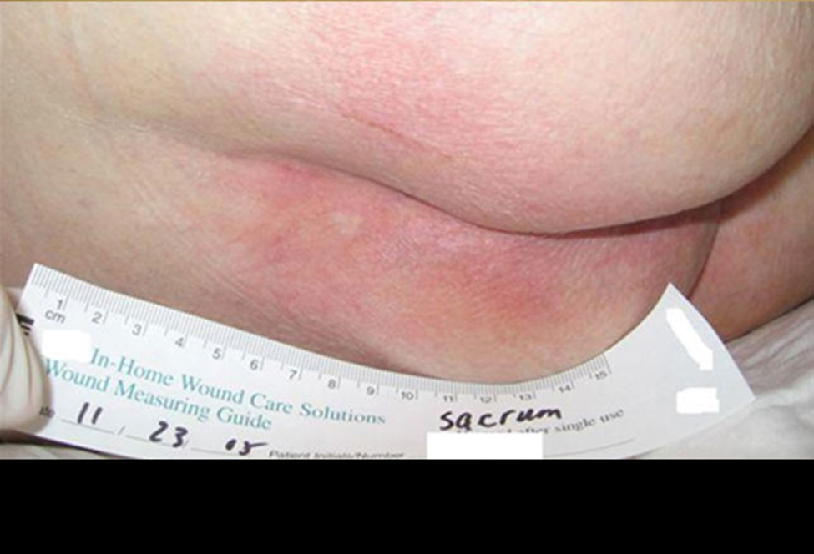
Staging and Evaluating a Pressure Sore
STAGE I:
  A persistent area of skin redness that does not disappear when pressure is removed.
  The skin is not broken.
  Skin appears red. Skin may not lighten “blanche” when lightly pressed/touched.
  The site may be tender, painful, firm, soft and warm or cool compared to the surrounding skin.

Slide 32
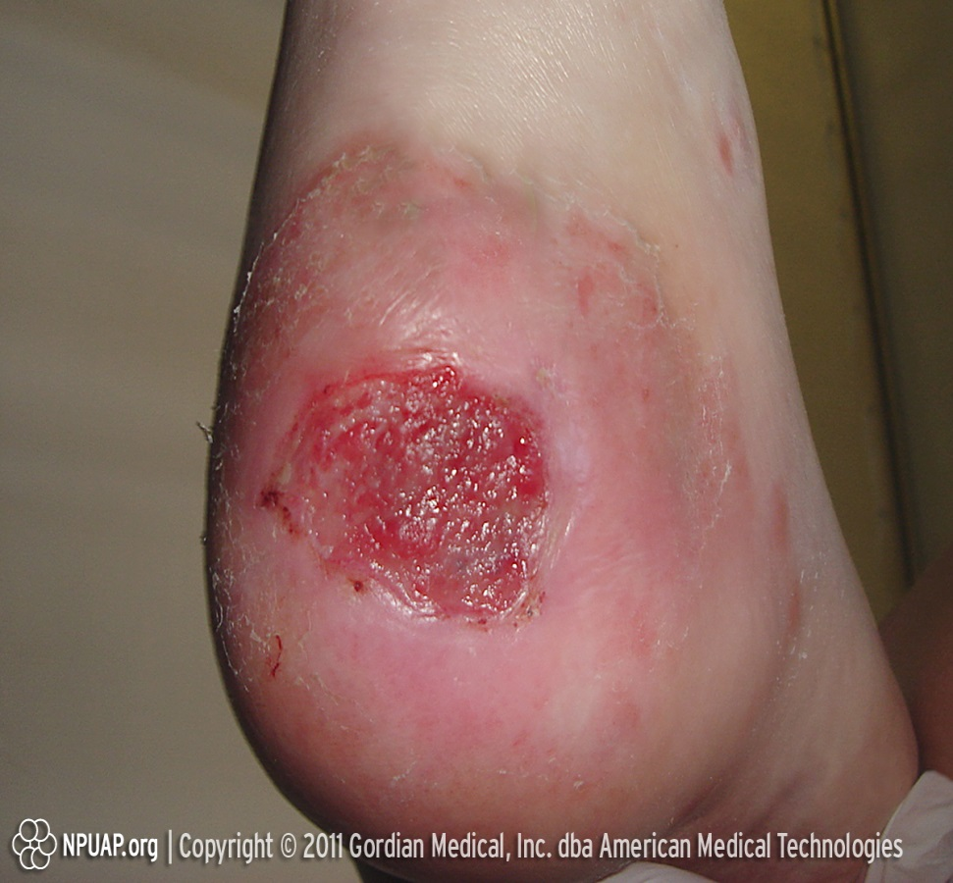
Staging and Evaluating a Pressure Sore
STAGE II:
  The outer layer of skin (epidermis) and the inner layer (dermis) is damaged or lost.
  The wound bed (open area) may be shallow and pinkish or red.
  The wound may look like an abrasion, fluid-filled blister or shallow crater.

Slide 33
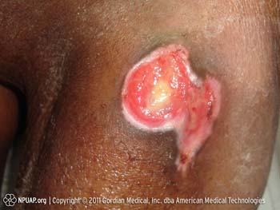
Staging and Evaluating a Pressure Sore
STAGE III:
  A full thickness of skin is lost.
  The loss of skin usually exposes the fat layer.
  The ulcer/sore looks like a “crater.”
  The bottom of the wound bed may have yellowish tissue.
  The damage may extend beyond what you see to below layers of healthy skin.

Slide 34
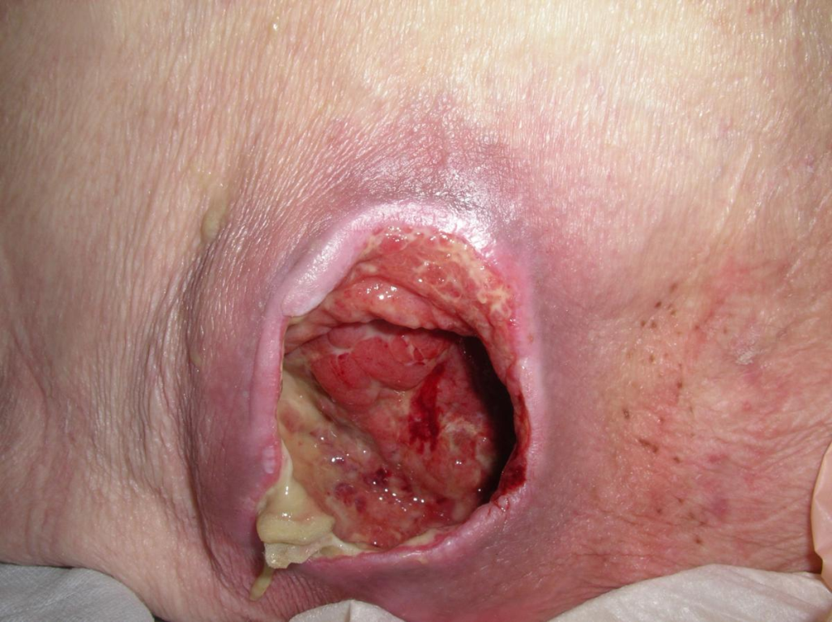
Stage 4
The pressure sore is very deep, reaching into muscle and bone and causing extensive damage.
Damage to deeper tissues, tendons, and joints may occur.
  (Park-Lee, Caffrey C. Pressure Ulcers among nursing home residents 2009)

Slide 35
Knowing the Risks and making a plan
The Braden Scale for Predicting Pressure Ulcer Risk, is a tool that was developed in 1987 by Barbara Braden and Nancy Bergstrom. The purpose of the scale is to help health professionals, especially nurses, assess a patient's risk of developing a pressure ulcer.
Planning to provide evidenced based interventions is the responsibility of the whole team including nurses, case managers, supervisors, families and direct care staff.
Either using Care Protocols or adding the prevention of skin breakdown as a Health Objective in the body of the Part V is acceptable.

Slide 36
Agency Policy
Your agency should have a policy on how they complete an assessment for every individual entering into your program.
Part of this assessment can be asking a nurse to complete a health history , a health assessment and using the Braden Scale as a decubitus ulcer risk assessment in addition to other assessments based on the person health status.
If a risk is identified then a plan for prevention and education of staff including the use of this curriculum can be established.

Slide 37
Standard Measurement Tools
Measurement tools help everyone talk the same language.
They help you give accurate information to health providers.
Examples are:
MediRule
Disposable rulers
Measuring tapes
* Follow your agencies policy.

Slide 38
Activity #5
Professionals commonly involved in treating skin breakdown (decubitus ulcers) are nurses, physicians, certified wound specialists that are nurses or occupational or physical therapists.
There is generally a wound clinic associated with most hospitals and home health care agencies and they often have special wound care teams.
Complete the Matching Game

Slide 39
Activity #6

Slide 40


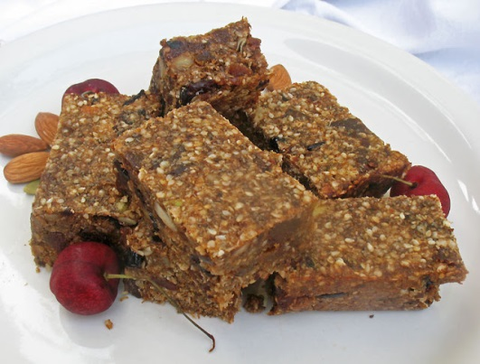
Break
Nutrition is key
Everyone gets a high protein snack and a bottle of water.

Slide 41
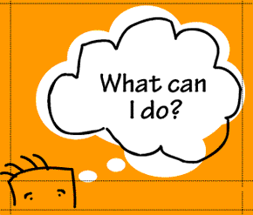
PREVENTION! PREVENTION!
What can YOU do?
  Repositioning:
    If in bed, reposition at least every two hours. Side to side, using pillows under one side of the back and then reposition again and place a pillow on opposite side of underside of back. Use pillows and cushions/wedges between and under knees. Place cushion support under feet and ankles. Follow all health practitioners, physical, and occupational therapist and nursing orders as prescribed.
    If in wheel chair, encourage individual to reposition every 15 minutes, use tilt feature on chair to reposition every hour.

Slide 42
PREVENTION! PREVENTION!
What can YOU do?
  Repositioning from one place to another:
    If the individual is non-ambulatory it is recommended that the individual changes physical position every two hours. For example,
      The individual is sitting in their wheel chair and then staff assist to transfer the individual to recline in the recliner.
      The individual is reclining in the recliner, the staff will assist to transfer the individual to lie in bed to stretch out and relax.
      This can vary depending on the individual’s daily planned schedule.

Slide 43
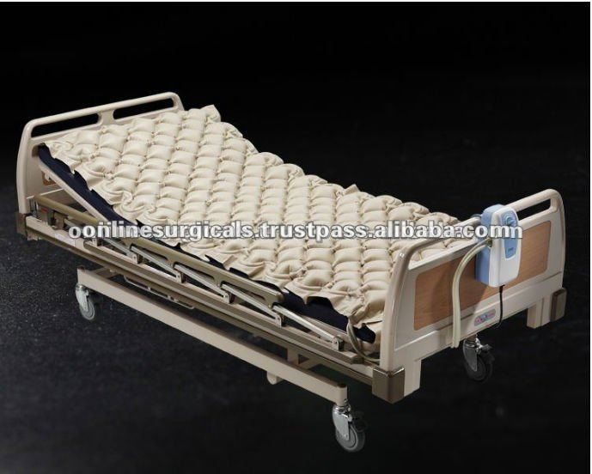
PREVENTION! PREVENTION!
What can YOU do?
  Support:
    Special ordered air mattresses if medically necessary
    Wedges, cushions, and pillows. These are recommended and ordered by Physical and Occupational Therapists and Physicians.

Slide 44
Proper Skin Care
    KEEP THE SKIN CLEAN AND DRY: Clean the skin with a mild soap and warm water and rinse thoroughly. Gently pat dry.
    Apply Lotions and ointments as prescribed- to prevent skin breakdown. This promotes skin integrity. It can be therapeutic to lightly massage the skin with prescribed lotions to prevent skin breakdown. This will also promote blood flow and circulation. Lightly massage the area with a “circle 8” motion with the fingertips.
    Never massage over an area of skin that is reddened or there is skin breakdown.

Slide 45
Proper Skin Care Continued
  Inspect skin daily- Daily Health Checks. Watch for any changes in the skin and report this immediately!
    Inspect for wrinkles and folds in the bedding and clothing that can irritate the skin and fix them.
    Manage incontinence-This will help keep the affected area clean especially if the sore is on the sacral, buttocks or groin area. Checking the individual at a minimum every two hours for incontinence and changing them immediately when wet or soiled will help prevent breakdown.
    Never double diaper

Slide 46
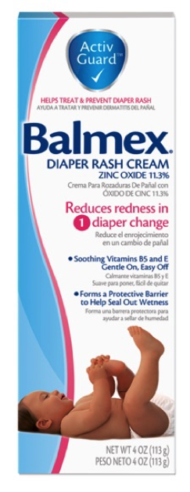
Activity #7
Barrier Ointment Demonstration
Care of the Skin Demonstration

Slide 47
Wheel Chair Care and Assessment
Wheel chair should be inspected daily and cleaned.
Inspect cushion for signs of wear, for proper inflation, and for proper placement (facing correct direction).
Yearly PT wheel chair evaluation or as needed.
Inspect brakes, arm rests, foot rests, head rests, wheels and belts and contact wheel chair vendor as needed for repairs.
Make sure that all attachments, such as trays and tie downs are in good working order and are clean.

Slide 48

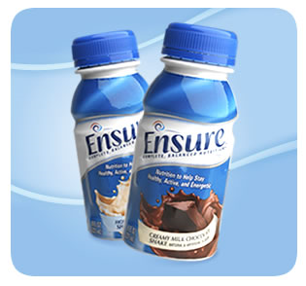
Other Interventions
What can YOU do?
  Nutrition:
    Healthy diet: this will promote wound healing. Physician may order an increase in calories and fluids, a high protein diet and vitamins and minerals to promote wound healing.

Slide 49

Other Interventions
What Can You Do?
      Drink Enough: Good hydration is important to maintaining good skin integrity.
      Offer fluids; especially water to the individual hourly as tolerated during awake hours except for individuals on fluid restriction protocols.

Slide 50
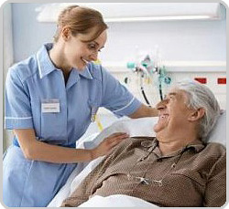
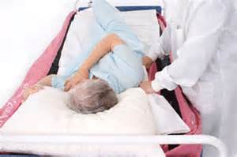
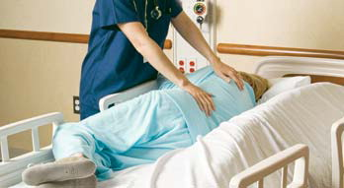
Prevention and Early detection and treatment save lives and human suffering!

Slide 51
What should healthy skin look like?
Free of rashes, cuts and scratches.
Warm and soft to the touch.
Moves easily and falls back in place when moved.
Lays evenly over joints and other areas with a soft fat pad under the skin.
Free of flaky and dry areas
Even coloring of skin over the body.

Slide 52
To protect your skin the CDC says you should:
Put on sunscreen with sun protective factor (SPF) 15 or higher and with both ultraviolet A and ultraviolet B (UVA and UVB) protection. Reapply sunscreen after swimming and excessive sweating.
Seek shade and consider wearing a wide-brimmed hat.
Cover up with clothing and sunglasses.
Avoid using tanning beds and sunlamps.
Put on insect repellent with DEET or Picaridin to protect from mosquito and tick bites.
(https://www.cdc.gov/family/minutes/tips/protectskin)

Slide 53
Report Any Change…
Know your agency’s Policy and Procedure for notifying supervisors when changes in a person’s health are identified.
Follow your agencies chain of command and Alert the appropriate person immediately.
Follow all nursing and physician’s care plans and orders.
Look for regularly ordered and/or PRN creams and ointments and use as directed.
Alert medical practitioner if no improvement in any skin problem.
Ask the individual if they have any areas that are causing discomfort or pain.
Watch and observe the individuals that cannot talk for signs of discomfort such as; grimacing, restlessness, behavior, crying, lack of appetite, etc. and report these changes.

Slide 54
Document, Document!
Clearly document when staff notices the problem.
What did you do?
Whom did you contact?
What instructions were given?
How did you implement the instructions?
What was the result?
If the result was not effective, what did you do?
What is your plan?

Slide 55

Thank You…
For always following the protocols.
For always providing these interventions with care.
For always being observant and reporting all changes.
For always documenting.
For working as a team to prevent skin breakdown, falls and other injuries to the individuals we support.
Thank you for coming!

Slide 56
References
Berkowitz, D. et al. (2014 October). Preventing pressure ulcers in hospitals: A tool kit for improving quality care. Agency for Healthcare Research and Quality. Retrieved from: https://www.ahrq.gov/professionals/systems/ hospital/pressureulcertoolkit/index.html
Pressure ulcers: Prevention and management of pressure ulcers. (2014) National Guideline Clearinghouse. Retrieved from: https://www.guideline.gov/search?q=pressure+ulcers
Health care protocol: Pressure ulcer prevention and treatment protocol. (march 2014). Institute for Clinical Systems Improvement. Retrieved from: https://www.icsi.org/_asset/6t7kxy/PressureUlcer.pdf
Park-Lee, E. Caffery, C. (2009, February). Pressure ulcers among nursing home residents: United States, 2004. National Center for Health Statistics. Retrieved from: www.cdc.gov/nchs/products/databriefs/db14.htm
Sandra M. Nettina. (2010). Manual of Nursing Practice [Woltz Kluwer Health] Lippincott Williams & Wilkins · (8th ed.,rev.) Ambler Penn.

