Slide 1
Virginia Prescription Monitoring Program
C.A.R.E Presentation
February 27, 2015
Ralph Orr
Director, Virginia Prescription Monitoring Program

Slide 2
Notes:
Pain relievers, tranquilizers, stimulants and sedatives combined are higher than marijuana initiation numbers

Slide 3
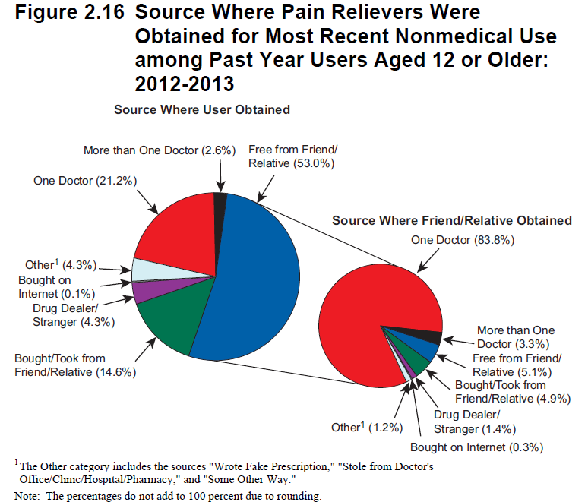

Slide 4
Notes:
Almost 74% of all drug/poison deaths are due to prescription drugs

Slide 6
Prescription Monitoring Program
24/7 Database of Schedule II – IV Prescriptions
Pharmacies, dispensing physicians report within 7 days
Reporting exemptions include: samples; emergencies; administration of covered substances; dispensing to patients in nursing homes, hospitals, hospice; veterinarians; narcotic maintenance treatment program
PMP is interoperable with 17 states, including WV, KY & TN
Notes:
NC interoperability is pending
DC is in the process of establishing a PMP, intends it to be interoperable
PMP does not include veterinary medicine

Slide 7
Who May Get PMP Information?
Prescribers and Pharmacists for their patients
Investigators for licensing boards, if there is an open investigation
Certain law enforcement agents, if there is an open investigation
Patients for their own prescription history
PMP may provide unsolicited reports on recipients to their prescribers or law enforcement, if criteria for potential misuse are met
PMP may not provide unsolicited reports on prescribers to DHP investigators or law enforcement
Notes:
3/13 through 9/14 521 patients met criteria for prescriber reporting; 3977 letters and emails sent to prescribers;
6/1/13 through 9/8/14 220 met criteria for state police, resulting in 109 cases opened

Slide 8
Days supply
Pay:
01 = Private Pay
02 = Medicaid
03 = Medicare
04 = Commercial Ins.
05 = Military Inst. and VA
06 = Workers Comp
07 = Indian Nations
99 = Other

Slide 12
Governor’s Task Force on Prescription Drug and Heroin Abuse
Five Workgroups
Initial Recommendations
Next meeting March19, 2015
See link to Task Force information at www.dhp.virginia.gov

Slide 13
Mandatory PMP registration of prescribers
§ 54.1-2522.1. (Effective July 1, 2015)
Registration with the PMP upon filing an application for licensure or renewal of licensure, if the prescriber is not already registered
HB1841: Adds Pharmacist and allows for registration not tied to renewal (Eff. 1/1/2016)

Slide 14
Mandatory use of PMP by prescribers
The prescribing of benzodiazepine or an opiate anticipated to last more than 90 consecutive days and “for which a treatment agreement is entered into”*
Or drugs approved for use in opioid addiction therapy shall, prior to or as a part of execution of a treatment agreement with the patient

Slide 15
QUESTIONS?

