Slide 1
Enterprise Investment Board
December’s Monthly Meeting

Slide 2
Agenda
Establish Quorum
Review Action Items
Celebrate Success
EPMO Recommendations
Q&A Interactive Session
Appendix – Project Health

Slide 3
Celebrate Success
Q4 2023 Successes
Launched EPMO Intake Services, EIB, EPMO SharePoint site, EIB WordPress site for communication to CSBs, and added standing agenda item to Monthly Data Management Committee (DMC) meeting.
Received very positive feedback on the transparency and visibility of the new project intake process from the Lunch and Learn and other outreach events (ex. Facility Directors, Facility IT Directors, and DMC Co-Chairs).
EPMO Intake Services and Senior PMs have developed relationships with the primary business leads to further the EPMO’s connection with the program side of the agency.
In early October, EPMO discovered capacity of some business analysts and used this time to:
  perform business case development work on Athelas PoC, which led to the EIB’s decision to close the intake. Based on the detailed reasoning for the closure documented in the minutes, the requester understood and accepted the EIB’s decision;
  perform Pre-EIB Request Review for December’s EIB meeting;
  increase the number of intakes actively being worked.
To date, we have closed 12, many that were carried over from ITIB, reducing the backlog.

Slide 4
Intake Pipeline (39)
Potential Future Projects List
ITIB Submissions (7)
ObservSMART
Elavon (electronic payments)
Web Portal for Marcus Alerts
Facilities Enterprise Human Resource System Solution (formerly HOPS HR)
Fiscal Note/Fireside Chat
EDCC Integration
Discharge Assistance Planning
EIB Submissions (16)
Microsoft Power BI (powerbigov.us)
Grandfathered in – No Intake Form (3):
AAIDD/Supports Intensity Scale
Counter Tools
VA Navigator
Intake Submission Not Occurred (13)
Tickit Health
EHR – ADC and Integration w/ EHR Catawba and SEVTC
EHR - OnePlan
Update legal status code in Avatar
EHR - Oracle Millennium (Mythics/CAI)
EHR - text communication with PHI
Lighthouse Central Registry for OTPS
PM tool (ex. Sensei IQ vs JIRA)
4 because of expiring IT contracts list provided by Procurement

Slide 5

Next Step – Close
Recommendations to Close
Community
Clinical/Facilities
ObservSMART
Operations
N/A
N/A
Unfunded, per intake form
Included in IT Strategic Plan

Slide 6
Next Step – Approve for Project
Recommendations to Project
Community
Not Ready
Clinical/Facilities
Not Ready
Operations
Not Ready​
Unfunded, per intake form
Included in IT Strategic Plan

Slide 7
In Progress – Business Case Development
Progress Update
Community
None
Clinical/Facilities
Language Interpretation & Translation Solution
Operations
Gartner Consulting Services
Facilities Clocks & Badges Replacement
UKG Dimensions/Pro Migration & Implementation
Patient ID Armband Integrated Solution
ePrescribe Discharge Medication Billing
EDCC Integration /
Smartchart Network
Unfunded, per intake form
Included in IT Strategic Plan

Slide 8
As time permits – Business Case Development
EPMO Pipeline Backlog
Community
None
Clinical/Facilities
Discharge Assistance Planning (DAP)
Operations
Annual subscription renewal of Sensei
Financial Management System
Waystar ECOS Assessment
Telehealth Services
Unfunded, per intake form
Included in IT Strategic Plan

Slide 9
Next Step – Start Business Case Development
EPMO Pipeline Backlog
Community
None
Clinical/Facilities
Facilities Enterprise Vital Signs Integration
Operations
Enterprise Human Resource Information System Solution
Elavon (electronic payments)
Fiscal Note/Fireside Chat
Cashless Payment Solution (VCBR)
OSVP Database
MART Master Scheduler
Unfunded, per intake form
Included in IT Strategic Plan

Slide 10
Next Step – Pre-EIB Request Review
Intakes Submitted After EIB Deadline
Community
None
Clinical/Facilities
DBHDS Public Safety Application: Omnigo (remaining facilities)
Operations
None
SynMed (contract renewal)
Unfunded, per intake form
Included in IT Strategic Plan

Slide 11
January EIB Meeting
Tuesday, 01/09/2024
Key Dates for Next EIB Session
12/15/2023 EIB Submission Form Deadline
01/04/2024 EIB / Data Modernization Program Sync Up w/Kathleen Graham
        Review new intakes submitted across the agency for data modernization program alignment (to pursue great on future state vs better on current state)
12/27/2023 EIB Priority List for Jan EIB (Community) w/Margaret Steele and Jean Dailey
12/28/2023 EIB Priority List for Jan EIB (Facilities/Clinical) w/Lauren Cartwright and Charles Mathenge
12/28/2023 EIB Priority List for Jan EIB (Operations) w/Russell Accashian and Kathleen Graham
        Review newly submitted intakes under your area that need prioritization to be worked as a business case, prioritize that list, get awareness of upcoming intake forms to be submitted, bring awareness to any scope/schedule/budget change requests for active approved projects

Slide 12
Appendix

Slide 13
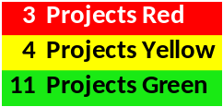
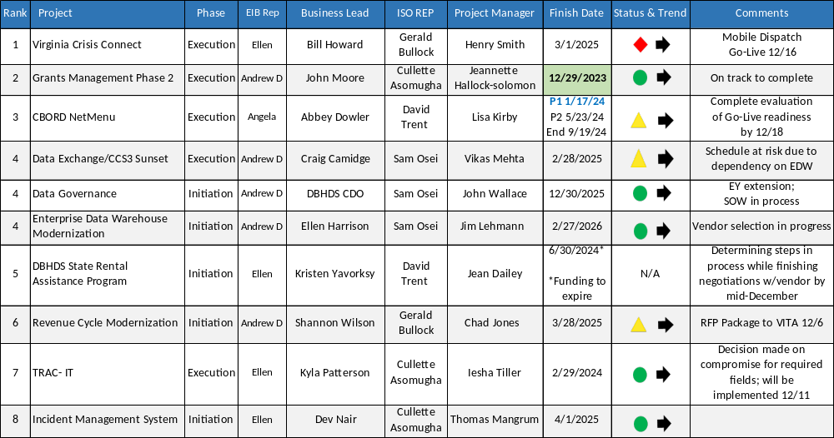
Project Health
Active Status Report 12-08-23
*Bold/green finish days due to complete within next 90 days

Slide 14
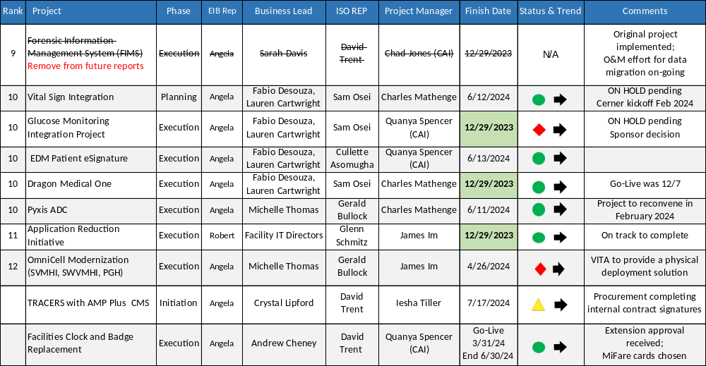
Project Health
Active Status Report 12-08-23
*Bold/green finish days due to complete within next 90 days

Slide 15


90 Days to Implementation
All projects implementing prior to February 27, 2024
  Three projects green, to complete on time by 12/29/23
  EHR Enterprise Dragon Medical One
    Go-Live scheduled 12/7/23
  Application Reduction Initiative
Grant Management Phase II
  One project at risk (details on slide 6)
    Glucose Monitoring Go-Live postponed, on hold
4 projects within 90-day implementation window
In Production

Slide 16


Project NOT Green
2 of 7
VCC
  Mobile Dispatch training is underway, preparing for Go-Live mid December
  Path to Green: Obtaining approval for a change request through VITA
    Identify scope/schedule/budget changes and submit to VITA the change request
    Create a readiness checklist for Mobile Dispatch to go into production
  Upcoming Milestones:
    Complete Dispatch Training by December 12th
    Mobile Dispatch Go-Live December 16th
    Execute emergency contract and SOW for subscription by December 31st
CBORD NetMenu
  Preload activities 94% complete; PROD migration 12/11 for solution to remove final single allergy
  Path to Green: Adjust schedule in Planview for delays and scope decision by December 18th
  Upcoming Milestones:
    Identify critical interface/EHR issues to be resolved before go-live by December 6th
    Facilities complete go-live checklist by December 8th;
    Evaluate go-live readiness by December 18th
    Resolve all critical issues during Dec window December 9th – 19th
7 Projects
off track

Slide 17
Project NOT Green
3 of 7
7 Projects off track
Data Exchange CCS3 Sunset
  Realized risk of EDW vendor contract negotiations delaying the schedule
  Path to Green: Determine changes to schedule after EDW vendor finalized
  Upcoming Milestone: Finalize Spec document by December 31st (not impacted by risk)
Revenue Cycle Modernization
  Final RFP package submitted to VITA December 6th
  Path to Green: VITA review to occur week of December 18th
  Upcoming Milestone: Publish RFP in eVA by December 22nd
Tracers with AMP Plus CMS
  Procurement to advise of contract approval status
  Path to Green: Obtaining fully executed contract
  Upcoming Milestone: Meeting with Business Owners to review Stakeholder Register by December 15th

Slide 18
Project NOT Green
2 of 7
7 Projects off track
  Glucose Monitoring
    Go-Live postponed, project on hold pending rescoping decision by Project Sponsor​
    Path to Green: Business stakeholder working with intake team for justification of rescoping
    Upcoming Milestones: Presentation to Executive Sponsor 12/12 outlining gaps and constraints
  OMNICELL Modernization
    VITA solution team is still vetting the new physical server requirements
    Path to Green: ​Rescope the project with the vendor and VITA
    Upcoming Milestones: Rescoped project by January 12th

