Slide 1
Enterprise Investment Board
January 2024 Monthly Meeting

Slide 2

Agenda
A Very Happy New Year To Everyone !
Establish Quorum
Review Action Items
Celebrate Success(es)
Intakes & EPMO Recommendations
Decisions from EIB
Q&A Interactive Session
Appendix – Project Health

Slide 3
Celebrate Success
Recent Successes
This month has seen continued optimization of the process to address intakes in a timelier fashion.
The involved personnel have proven to bring value to the efforts underway, thereby solidifying the team for future success.
The funneling of requests through the “One-Stop Shop” is continuing to show immense value in terms of visibility and consolidation of investments.
Continued support of the Senior Leadership Team has been invaluable for providing direction and structure to meet the dynamic needs of our Agency.

Slide 4
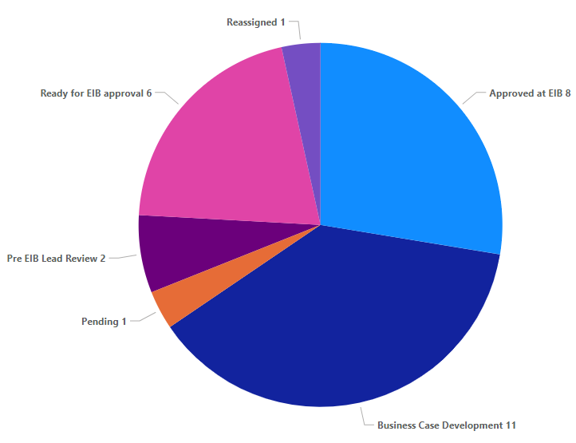

Intake Pipeline (32)
Potential Future Projects List
Open ITIB Submissions (7)
Elavon (electronic payments)
Web Portal for Marcus Alerts
Facilities Enterprise Human Resource System Solution (formerly HOPS HR)
Fiscal Note/Fireside Chat
ObservSMART
EDCC Integration
Discharge Assistance Planning
Grandfathered in – No Intake Form (3):
AAIDD/Supports Intensity Scale
Counter Tools
VA Navigator
Business Case Backlog
Open EIB Submissions (29)
Closed (3)
Microsoft Power BI (powerbigov.us)

Slide 5
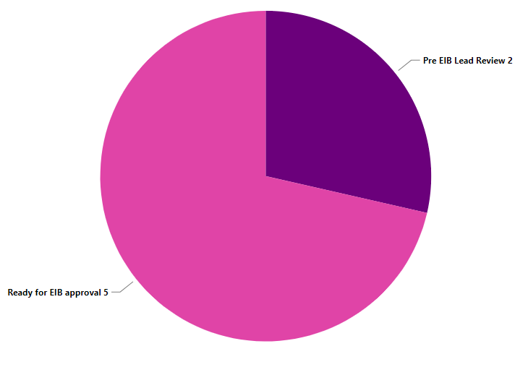
New Intakes
New Intakes (7) to be reviewed in January
 | Name of Request | Status
Facilities / Clinical | DBHDS Public Safety Application: Omnigo | Ready for EIB approval
 | SynMed (contract renewal) | Ready for EIB approval
 | Facilities EHR OnePlan (Treatment Planning) Beta Partnership | Ready for EIB approval
Operations | HowSo; Formerly DivePlane | Pre EIB Lead Review
 | Replace Little CARS Database | Pre EIB Lead Review
Community | CAI Staff Augmentation for IMS Replacement/Legacy Systems Data; Analysis and Migration | Ready for EIB approval
 | Central Registry for Opioid Treatment Providers (OTP) | Ready for EIB approval

Slide 6
Upcoming Intakes
Potential Future Projects List
Potential Intakes where Submissions have not yet been made (6)
Tickit Health
EHR – ADC and Integration w/ EHR Catawba and SEVTC
Update legal status code in Avatar
EHR - Oracle Millennium (Mythics/CAI)
EHR - text communication with PHI
PM tool (ex. Sensei IQ vs JIRA)

Slide 7
Next Step – Revisit
EPMO Recommendation
ObservSmart:
During the 12/14/23 Facilities Enterprise Technology Collaboration meeting, it was proposed to combine the business needs expressed in the intakes for Patient ID Armband Integrated Solution and ObservSMART into a single intake, with the potential result to allow for ObservSMART at some facilities and Patient ID Armband at other facilities to accommodate the different business needs of each facility.
Different facilities are inclined towards one or the other solution.
Facilities have expressed issues with the armbands in terms of ease of damage / removal and erroneous exchangeability amongst individuals.
Some facilities do not want either solution.
EPMO Recommends to combine both requests to:
Effectively solve disparate needs of facilities
Demonstrate that an enterprise solution can be a combination of solutions potentially.

Slide 8
Next Step – Close
Recommendations to Close
Renewals for existing contracts
Reviewed by BA for completeness
PM/Intake Lead has addressed all VITA needs where warranted
Community | Clinical/Facilities | Operations (3)
 |  | Gartner Consulting Services
 |  | Sensei Subscription Renewal
 |  | HowSo/Diveplane
Notes:
Gartner –
Recommending for closure.
Budget Cuts affected the renewal of the Gartner Services.
No work remaining for Intake Services to do and IT has all the approvals needed in case funding is received.
Sensei -
Amount of money below the threshold, no CTP needed.
HowSo -
No PGR amendment needed.
Requisition to be submitted – ensure this is done

Slide 9
Next Step – Approve for Project
Recommendations to Project
Community | Clinical/Facilities | Operations
None | None | None

Slide 10

In Progress – Business Case Development (10)
Progress Update
Community (1) | Clinical/Facilities (7) | Operations (2)
CAI Staff Augmentation for IMS Replacement/Legacy Systems Data; Analysis/Migration Prep | Language Interpretation & Translation Solution | EDCC Integration / Smartchart Network
 | Facilities Clocks & Badges Replacement | Waystar ECOS Assessment
 | UKG Dimensions/Pro Migration & Implementation
 | Patient ID Armband Integrated Solution
 | ePrescribe Discharge Medication Billing
 | Discharge Assistance Planning (DAP)
 | Telehealth Services
Unfunded

Slide 11
Next Step – Start Business Case Development (14)
EPMO Pipeline Backlog
Community (1) | Clinical/Facilities (7) | Operations (5)
Central Registry for Opioid Treatment (OTP) | DBHDS Public Safety Application: Omnigo (remaining facilities) | Financial Management System
 | SynMed (contract renewal) | Enterprise Human Resource Information System Solution
 | Facilities Enterprise Vital Signs Integration | Fiscal Note/Fireside Chat
 | Cashless Payment Solution (VCBR) | Elavon (electronic payments)
 | OSVP Database | Replace Little CARS Database
 | MART Master Scheduler
 | Facilities EHR OnePlan (Treatment Planning) Beta Partnership
Unfunded

Slide 12
Next Step – Pre-EIB Request Review
Intakes Submitted After EIB Deadline
Community | Clinical/Facilities | Operations
 | OnShift ECOS

Slide 13



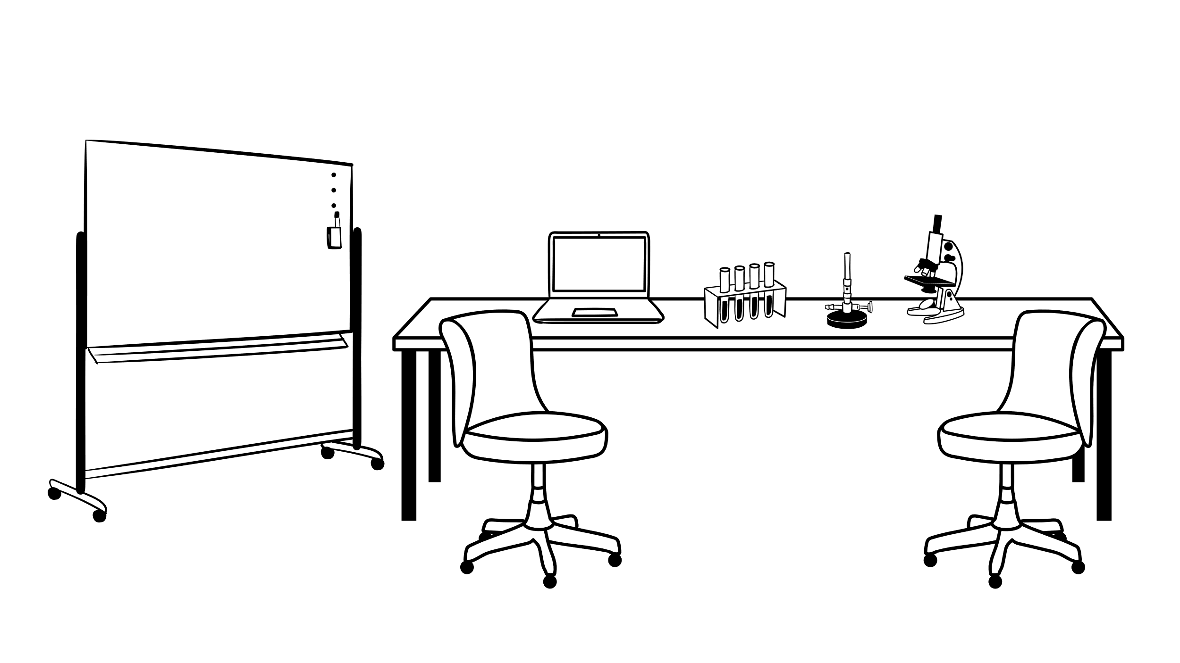



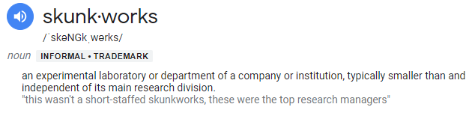
Coming Soon………. EIB Process Enhancements
The Future is Now
We want to enhance and improve the process
So that we can:
The folks at the EPMO ‘Skunkworks’* have been thinking and talking
Process
more intakes faster.
Introduce a FastTrack (Case By Case basis) Model.
Utilize / Repurpose existing resources, or add new resources as needed.
Reduce SLAs for a timelier delivery
Assess Autonomy for certain types of intakes.
…… and more to be introduced in the next session.
That’ll make us COOL like these guys !

Slide 14
Active Projects – Change Request
Pyxis ADC Project Change Request
Due to Omnicell Modernization project closure, include Omnicell facilities within scope
of BD Pyxis Project
Recommendation: Increase scope of existing project to include facilities approaching
end of life with Omnicell that were covered under the now closed Omnicell
Modernization project, as well as any facility not covered under either project
(Example: Catawba)
Pyxis ADC Project Sponsor Guidance
There is an immediate need to standardize the enterprise management of the root pharmacy formulary and management of the nursing related configuration, rules and parameters. Decisions are needed to progress the project and for O&M this will be ongoing. Project cannot be executed effectively without the roles below.
Recommendation:
Assign or hire a centralized pharmacy system administrator immediately
Assign or hire a centralized nursing system administrator immediately

Slide 15
February EIB Meeting Tuesday, 02/13/2024
Key Dates for Next EIB Session
01/29/2024 EIB Submission Form Deadline
01/31/2024 EIB / Data Modernization Program Sync Up w/Kathleen Graham
Review new intakes submitted across the agency for data modernization program alignment (to pursue great on future state vs better on current state)
01/30/2024 EIB Priority List for Jan EIB (Community) w/Margaret Steele and Jean Dailey
01/31/2024 EIB Priority List for Jan EIB (Facilities/Clinical) w/Lauren Cartwright and Charles Mathenge
01/31/2024 EIB Priority List for Jan EIB (Operations) w/Russell Accashian and Kathleen Graham
Review newly submitted intakes under your area that need prioritization to be worked as a business case, prioritize that list, get awareness of upcoming intake forms to be submitted, bring awareness to any scope/schedule/budget change requests for active approved projects

Slide 16
Appendix

Slide 17
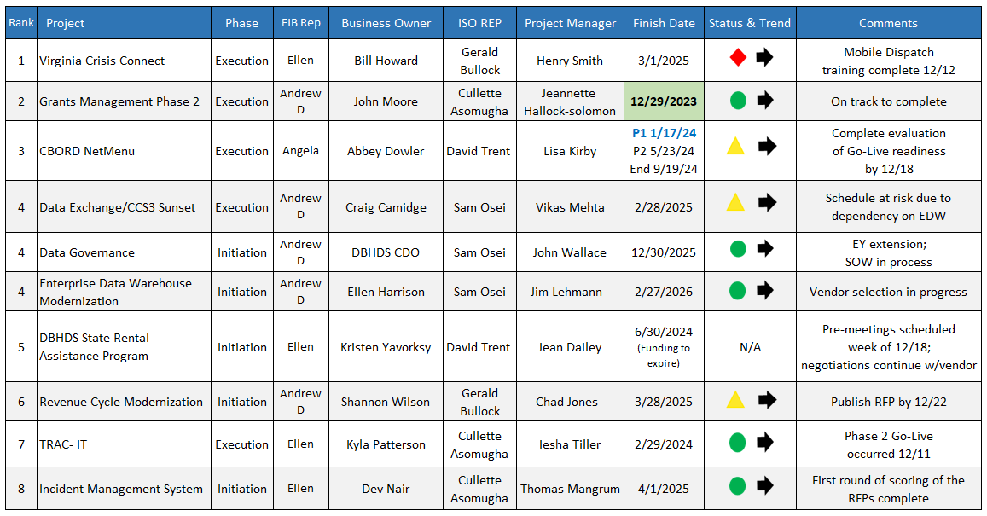
Project Health
Active Status Report 12-15-23
*Bold/green finish days due to complete within next 90 days

Slide 18
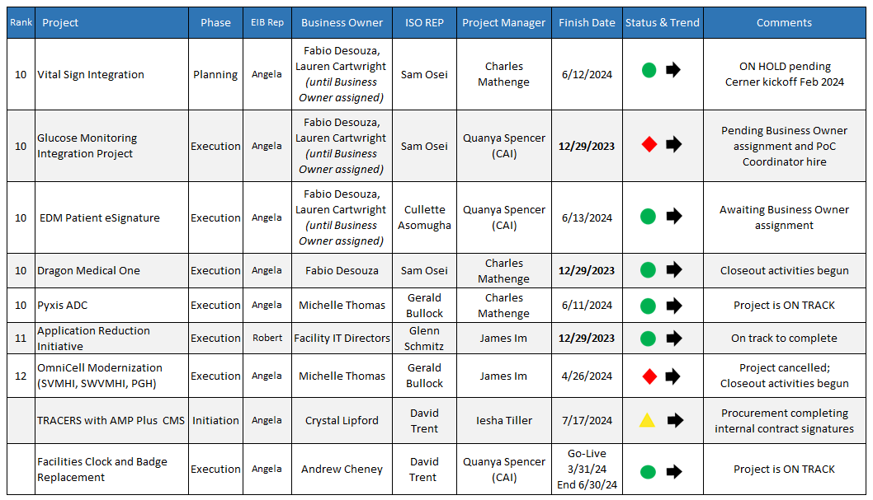
Project Health
Active Status Report 12-15-23
*Bold/green finish days due to complete within next 90 days

Slide 19


90 Days to Implementation
All projects implementing prior to March 12, 2024
Three projects green, to complete on time by 12/29/23
TRAC-IT Phase 2
Go-Live scheduled 12/11/23
Application Reduction Initiative
Grant Management Phase II
One project at risk (details on slide 6)
Glucose Monitoring Go-Live postponed, on hold
4 projects within 90-day implementation window
In Production

Slide 20


Project NOT Green
2 of 7
VCC
Mobile Dispatch training is complete
Path to Green: Create a change request through VITA
Complete new contract with Behavioral Health Link
Identify scope/schedule/budget changes and submit to VITA the change request
Upcoming Milestones:
Complete Readiness Checklist for re-launch to go in PROD by December 15th
Mobile Dispatch Go-Live December 16th
Execute emergency contract and SOW for subscription by December 31st
CBORD NetMenu
Preload activities now 96% complete; 4 facilities remaining
Path to Green: Adjust schedule in Planview for delays and scope decision by December 18th
Upcoming Milestones:
Facilities complete go-live checklist by December 8th
PROD migration occurred or critical bug fix December 8th
Part 2 of identifying critical EHR and interface issues by December 13th
Evaluate go-live readiness by December 18th
Resolve all critical issues during Dec window December 9th – 19th
7 Projects
off track

Slide 21
Project NOT Green
3 of 7
7 Projects off track
Data Exchange CCS3 Sunset
Realized risk of EDW vendor contract negotiations delaying the schedule
Path to Green: Determine changes to schedule after EDW vendor finalized
Upcoming Milestone: Finalize Spec document by December 31st (not impacted by risk)
Revenue Cycle Modernization
Final RFP package submitted to VITA December 6th
Path to Green: VITA reviewed early and will share results with agency next week
Upcoming Milestone: Publish RFP in eVA by December 22nd
Tracers with AMP Plus CMS
Procurement to advise of contract approval status
Path to Green: Obtaining fully executed contract
Upcoming Milestone: Meeting with Business Owners to review Stakeholder Register by December 15th

Slide 22
Project NOT Green
2 of 7
7 Projects off track
Glucose Monitoring
Go-Live postponed, Project Sponsor made decision to perform Path to Green activities​
Path to Green:
Project Sponsor assign a Business Owner and hire a Point of Care Coordinator
PM adjust required deliverables and implement mitigations for identified risks
Upcoming Milestones:
Presentation outlining gaps and constraints to Executive Sponsor December 11th
Sponsor will assign new Business Owner or a timeline by the January 9th EIB Meeting
Business Owner will verify Point of Care Coordinator is hired by end of January
OMNICELL Modernization
OMNICELL solution no longer feasible – EIB intake form submitted to address need
Path to Green: ​N/A – Project cancelled
Upcoming Milestones: Project closeout by January 12th

