Slide 1
Enterprise Investment Board
January 2024 Monthly Meeting

Slide 2

Agenda
A Very Happy New Year To Everyone !
Establish Quorum
Review Action Items
Celebrate Success(es)
Intakes, EPMO Recommendations
EIB Decisions
What’s next for EIB?
Q&A Interactive Session
Appendix – Active Projects Health

Slide 3
Celebrate Success
Recent Successes
State Rental Assistance Program (SRAP) was an ITIB project, which was successfully procured at the end of December 2023.
Contract Renewals addressed
  Sensei
  HowSo / Diveplane
  Tracers License renewal for WSH
Successful Roll outs
  Grants Management – Phase II
  Trac-IT
  Application Reduction
RFP Published for Revenue Cycle Modernization
3 Business Cases Completed

Slide 4
Intakes

Slide 5
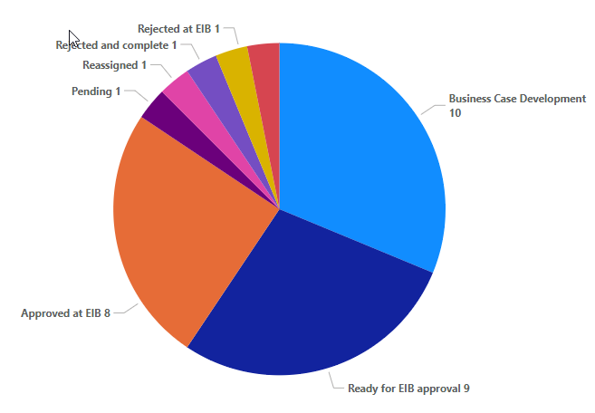

Intake Pipeline (32)
Potential Future Projects List
Open ITIB Submissions (7)
Elavon (electronic payments)
Web Portal for Marcus Alerts
Facilities Enterprise Human Resource System Solution (formerly HOPS HR)
Fiscal Note/Fireside Chat
ObservSMART
EDCC Integration
Discharge Assistance Planning
Grandfathered in – No Intake Form (3):
AAIDD/Supports Intensity Scale
Counter Tools
VA Navigator
Open EIB Submissions (29)
Closed (3)
Business Case Backlog
Microsoft Power BI (powerbigov.us)

Slide 6
Awareness - Upcoming Intakes
Potential Future Projects List
Potential Intakes where Submissions have not yet been made (6)
Tickit Health
EHR – ADC and Integration w/ EHR Catawba and SEVTC
Update legal status code in Avatar
EHR - Oracle Millennium (Mythics/CAI)
EHR - text communication with PHI
PM tool (ex. Sensei IQ vs JIRA)

Slide 7
EPMO Update and Recommendations

Slide 8

In Progress – Business Case Development (10)
Progress Update
Community (1) | Clinical/Facilities (7) | Operations (2)
CAI Staff Augmentation for IMS Replacement/Legacy Systems Data; Analysis/Migration Prep. Plan to approve this in the upcoming EIB, and perform BC development in parallel with the augmentation process (N/A) | Language Interpretation & Translation Solution (100%) | EDCC Integration / Smartchart Network (5%)
 | Facilities Clocks & Badges Replacement (100%) | Waystar ECOS Assessment (100%)
 | UKG Dimensions/Pro Migration & Implementation (20%)
 | Patient ID Armband Integrated Solution (50%)
 | ePrescribe Discharge Medication Billing (90%)
 | Discharge Assistance Planning (DAP) (30%)
 | Telehealth Services (60%)
Unfunded

Slide 9
Next Step – Revisit
EPMO Recommendation
ObservSmart:
  During the 12/14/23 Facilities Enterprise Technology Collaboration meeting, it was proposed to combine the business needs expressed in the intakes for Patient ID Armband Integrated Solution and ObservSMART into a single intake, with the potential result to allow for ObservSMART at some facilities and Patient ID Armband at other facilities to accommodate the different business needs of each facility.
  Different facilities are inclined towards one or the other solution.
    Facilities have expressed issues with the armbands in terms of ease of damage / removal and erroneous exchangeability amongst individuals.
    Some facilities do not want either solution.
  EPMO Recommends to uphold December’s EIB decision to close the ObservSmart Request:
    High Cost (even for a single facility) and not funded.
    The procurement vehicle will need to be assessed thoroughly. This may take a large amount of time, and the request for patient ID bands is high priority and needs a quick turnaround.

Slide 10
Next Step – Close
Recommendations to Close
Renewals for existing contracts
Reviewed by BA for completeness
PM/Intake Lead has addressed all VITA needs where warranted
Community | Clinical/Facilities | Operations (4)
 |  | Gartner Consulting Services
 |  | Sensei Subscription Renewal
 |  | HowSo/Diveplane
 |  | Waystar ECOS Assessment
Notes:
Gartner –
Recommending for closure.
Budget Cuts affected the renewal of the Gartner Services.
No work remaining for Intake Services to do and IT has all the approvals needed in case funding is received.
Sensei -
Amount of money below the threshold, no CTP needed.
HowSo -
No PGR amendment needed.
Requisition to be submitted – ensure this is done

Slide 11
Next Step – Approve for Project
Recommendations to Project
Community | Clinical/Facilities | Operations
None | Facilities Clocks & Badges Replacement (no project delivery handoff; execution in parallel) | None

Slide 12
EIB Decisions

Slide 13
Active Projects – Change Request
Pyxis ADC Project Change Request
  Due to Omnicell Modernization project closure, include Omnicell facilities within scope
  of BD Pyxis Project
  Recommendation: Increase scope of existing project to include facilities approaching
  end of life with Omnicell that were covered under the now closed Omnicell
  Modernization project, as well as any facility not covered under either project
  (Example: Catawba)
Pyxis ADC Project Sponsor Guidance
  There is an immediate need to standardize the enterprise management of the root pharmacy formulary and management of the nursing related configuration, rules and parameters. Decisions are needed to progress the project and for O&M this will be ongoing. Project cannot be executed effectively without the roles below.
  Recommendation:
    Assign or hire a centralized pharmacy system administrator immediately
    Assign or hire a centralized nursing system administrator immediately

Slide 14
New Intakes
New Intakes (5) to be reviewed in January against current priorities
Do we need approve these for Business Case stage?
Division | Name of Request
Facilities / Clinical | DBHDS Public Safety Application: Omnigo (Rank 8)
 | SynMed (contract renewal) (Rank 9)
 | Facilities EHR OnePlan (Treatment Planning) Beta Partnership (Rank 4)
Operations | Replace Little CARS Database (Rank 21)
Community | Central Registry for Opioid Treatment Providers (OTP) (Rank 20)

Slide 15
Next Step – Start Business Case Development (8)
EIB Business Case Backlog
Community (0) | Clinical/Facilities (4) | Operations (4)
None | Facilities Enterprise Vital Signs Integration (Rank 16) | Financial Management System (Rank 18)
 | Cashless Payment Solution (VCBR) (Rank 25) | Enterprise Human Resource Information System Solution (Rank 22)
 | OSVP Database (Rank 26) | Fiscal Note/Fireside Chat (Rank 23)
 | MART Master Scheduler (Rank 29) | Elavon (electronic payments) (rank 27)
Unfunded

Slide 16



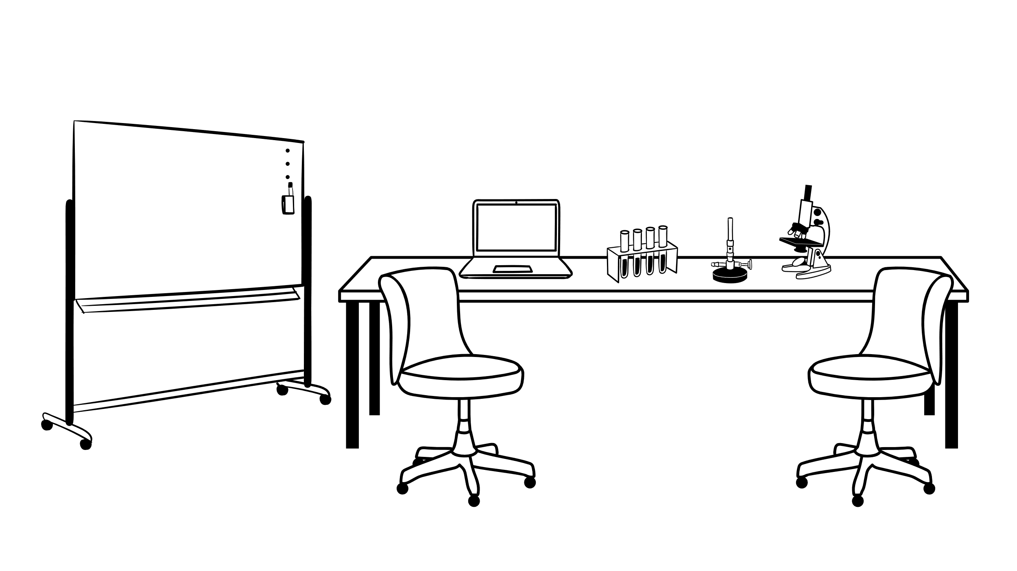

Coming Soon………. EIB Process Enhancements
The Future is Now
We want to enhance and improve the process
The folks at the EPMO have been thinking and talking
So that we can:
Process more intakes faster.
Introduce a FastTrack (Case By Case basis) Model.
Utilize / Repurpose existing resources, or add new resources as needed.
Reduce SLAs for a timelier delivery
Assess Autonomy for certain types of intakes.
Optimize
  business case template
  End to end process
  Reporting
Clarify S/M/l sizing (parameters)
We need to :
Optimize the business case template.
Fast track Project Management
Optimize the demand / capacity model
Optimize the prioritization framework.
Use the first EIB Iteration to learn and adapt to the Agency needs.
Revised and Refined EIB 2.0

Slide 17
February EIB Meeting
Tuesday, 02/13/2024
Key Dates for Next EIB Session
01/29/2024 EIB Submission Form Deadline
01/31/2024 EIB / Data Modernization Program Sync Up w/Kathleen Graham
        Review new intakes submitted across the agency for data modernization program alignment (to pursue great on future state vs better on current state)
01/30/2024 EIB Priority List for Jan EIB (Community) w/Margaret Steele and Jean Dailey
01/31/2024 EIB Priority List for Jan EIB (Facilities/Clinical) w/Lauren Cartwright and Charles Mathenge
01/31/2024 EIB Priority List for Jan EIB (Operations) w/Russell Accashian and Kathleen Graham
        Review newly submitted intakes under your area that need prioritization to be worked as a business case, prioritize that list, get awareness of upcoming intake forms to be submitted, bring awareness to any scope/schedule/budget change requests for active approved projects

Slide 18
Appendix

Slide 19
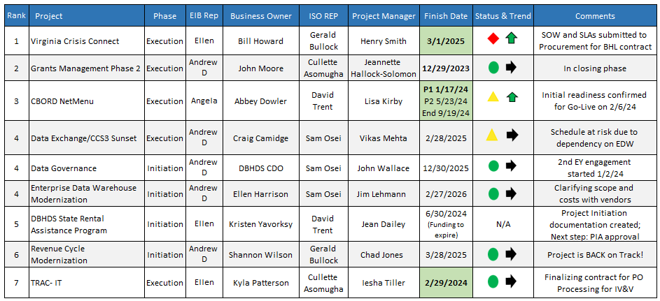
Project Health
Active Status Report 1-5-24
*Bold/green finish days due to complete within next 90 days

Slide 20
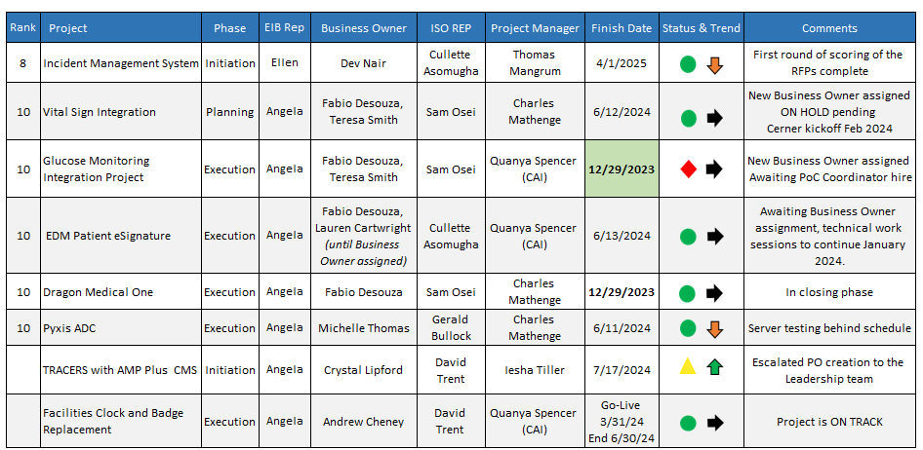
Project Health
Active Status Report 1-5-24
*Bold/green finish days due to complete within next 90 days

Slide 21



90 Days to Implementation
All projects implementing prior to March 29, 2024
  Two projects green, implemented, and in Closing Phase
Grant Management Phase II
Dragon Medical One
One projects green & implemented, finalizing IV&V contract
TRAC-IT Go-Live date was 12/11/23
  Three projects at risk (details on next slides)
    CBORD NetMenu Go-Live for Phase 1 is 2/6/24
    Virginia Crisis Connect Current Implementation date 3/1/24; pending new baseline
    Glucose Monitoring Go-Live postponed, on hold
6 projects within 90-day implementation window

Slide 22
Project NOT Green
2 of 5
5 Projects Off Track
Virginia Crisis Connect
  Replaced expired contract with new vendor
  Path to Green: Confirm scope of implementation work by 1/19/24
    Reconcile the budget by 1/26/24
    In process of updating schedule by 1/26/24
    Receive approved VITA change request 2/15/24
CBORD NetMenu (Phase 1 Go-Live 2/6/24)
  Final training events scheduled for week of January 8th
  Path to Green: Change request submitted to VITA; awaiting approval
    Continue verifying Go-Live checklist at each facility

Slide 23

Project NOT Green
3 of 5
5 Projects Off Track
Data Exchange CCS3 Sunset
  Realized risk of EDW vendor contract negotiations delaying the schedule
  Path to Green: Expedite RFP process and finalize RFP by March 1
    Continue specs for integration solution with CSB & EHR (not impacted by risk)
  Glucose Monitoring
    Go-Live postponed, No Point of Care Coordinator on-site ​
    Path to Green:
      Awaiting a Point of Care Coordinator
      Meeting scheduled 1/8/24 with new Business Owner
Tracers with AMP Plus CMS
  Procurement completed; licenses renewed
  Path to Green: Schedule will be updated week of 1/8/24 return to green status

